Slide 1

Trends in equity for contraception, pregnancy and delivery care
Aluísio J D Barros
International Center for Equity in Health
Federal University of Pelotas

Slide 2
Why equity?
Many societies see health as a human right, not a commodity
If so, every person is entitled to enjoy the best health achievable
We’re not all equal
But if health differences between groups
  Systematic patterns
  Produced by social processes rather than biology
  Widely recognized to be unfair
  → INEQUITY (Whitehead & Dahlgren (2006)

Slide 3
What do we measure?
Inequality is the measurable dimension of health inequity studies
  Differences, gaps, variation
  Of health status, exposure to risk factors, access to and utilization of health care services
  Across several dimensions (or stratifiers)
    Wealth, ethnicity, gender, education, age
Absolute and relative
  When comparing groups one can measure
    Distance = absolute, by difference
    Ratio = relative, by division

Slide 4
Mean coverage in each quintile for 54 CD countries
RM interventions are the most unequal!

Slide 5
Inequality – absolute or relative
Will use the slope index of inequality (SII):
a regression-based estimate of the difference between the top and bottom of the wealth scale
Absolute inequality
  Remains constant when all groups increase or decrease by the same amount (+ or – Y)
Relative inequality
  Remains constant when all groups increase or decrease by the same factor (× Y)
Will use the concentration index (CIX):
a Gini-like measure of concentration of intervention coverage across the population

Slide 6
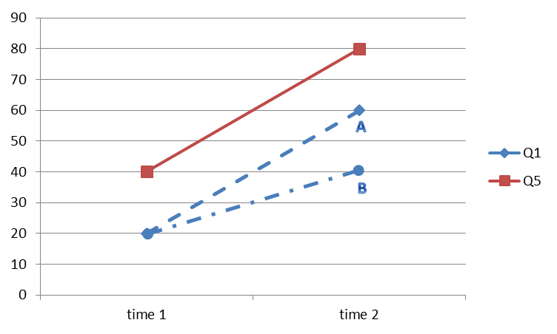
Inequality – improving?
<absolute, <relative
>absolute, <relative
>absolute, >relative

Slide 7
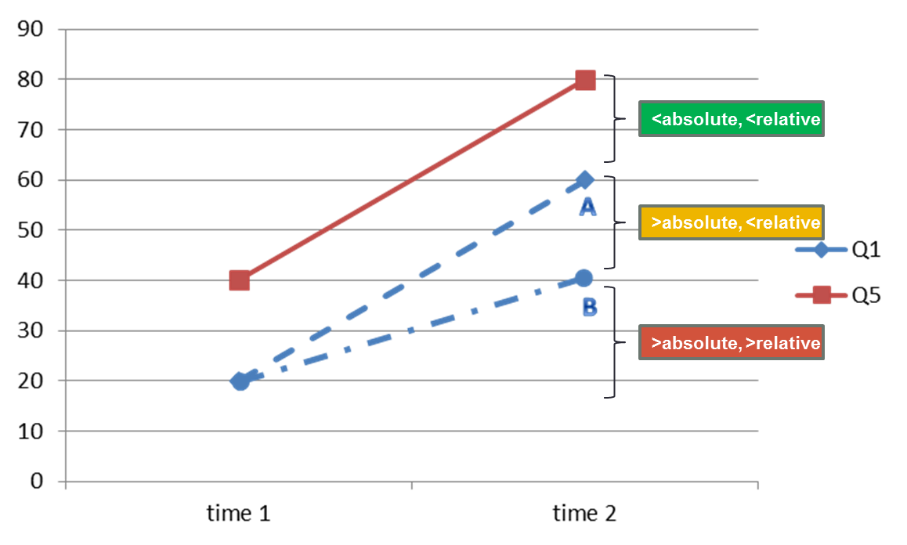
Trend plot – how to interpret?
Intermediate situation!
Only relative inequality improved
Worst situation
Very little change
Best situation!
Overall improvement

Slide 8
Equity trend analysis
Results for 36 countries
  With two surveys about 10 years apart
Family planning need satisfied
  % women using contraception among those in need
  Complex indicator based on many variables, some very subjective
  Difficult to calculate
  Makes more sense than contraceptive prevalence
Antenatal care 1+ visit with skilled provider
  At least 1 consultation with skilled provider during pregnancy
Skilled birth attendant
  Skilled attendant at child birth
  Skilled = doctor, nurse or midwife (with some local adaptations)

Slide 9
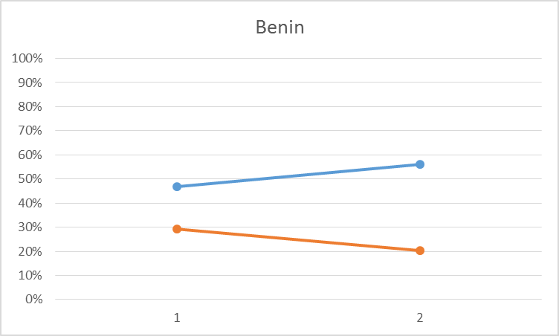

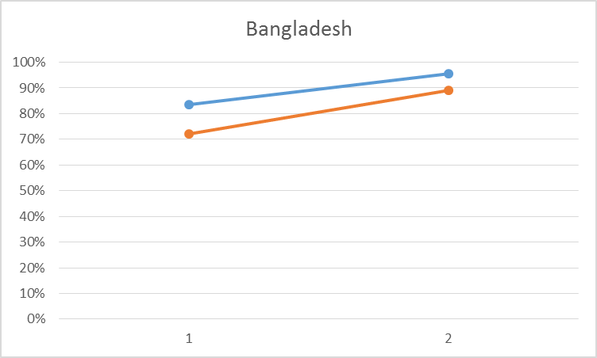
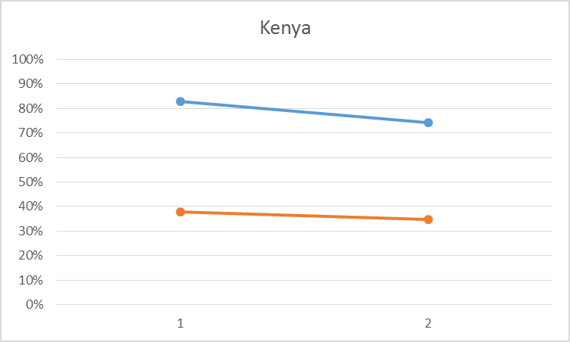
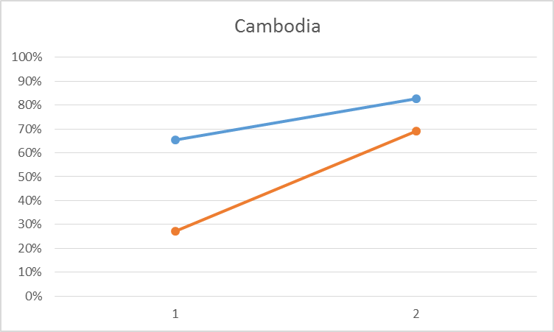
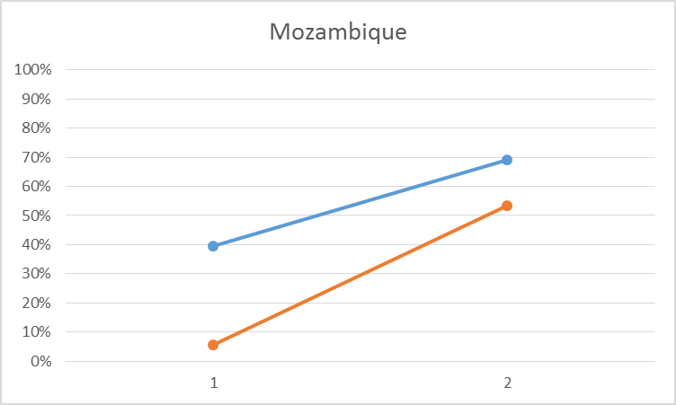
Family planning need satisfied
28/35 countries = 80% improved mean coverage

Slide 10
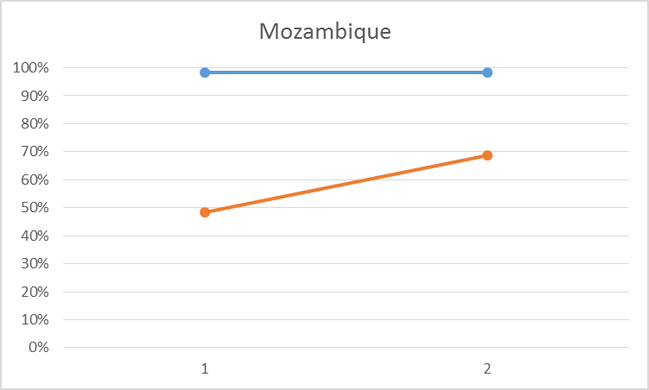
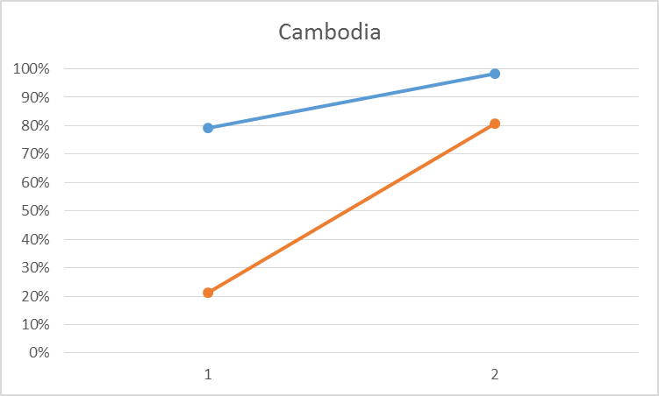
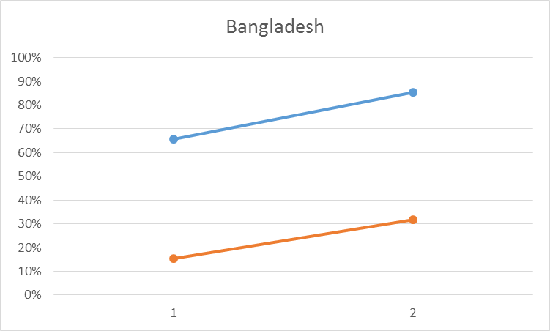
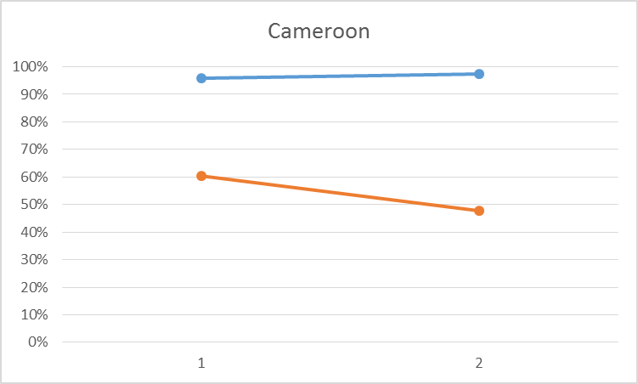
Antenatal care (1+ skilled)
28/36 countries = 78% improved mean coverage

Slide 11
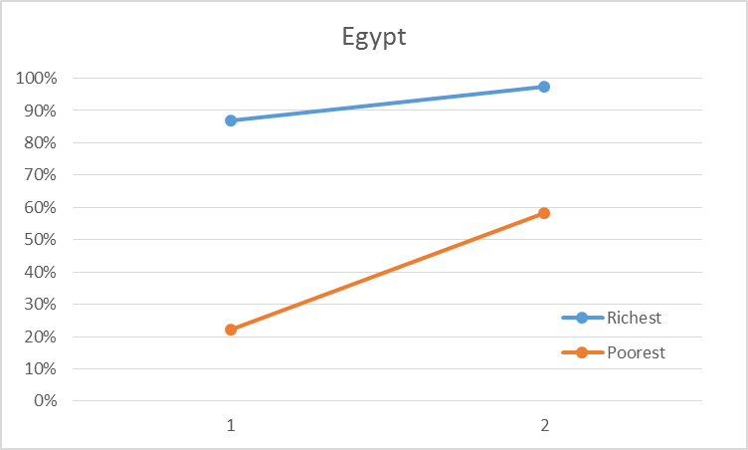
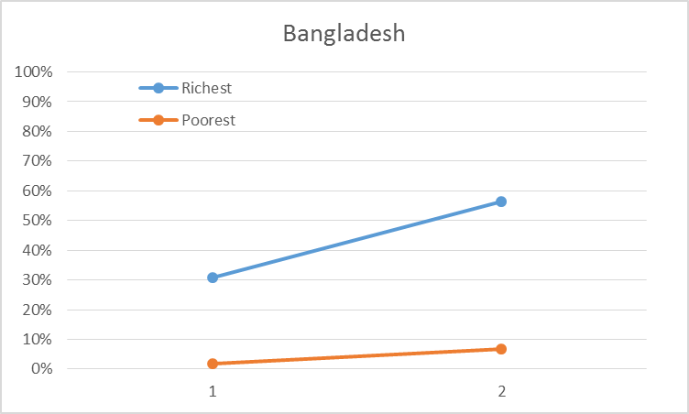
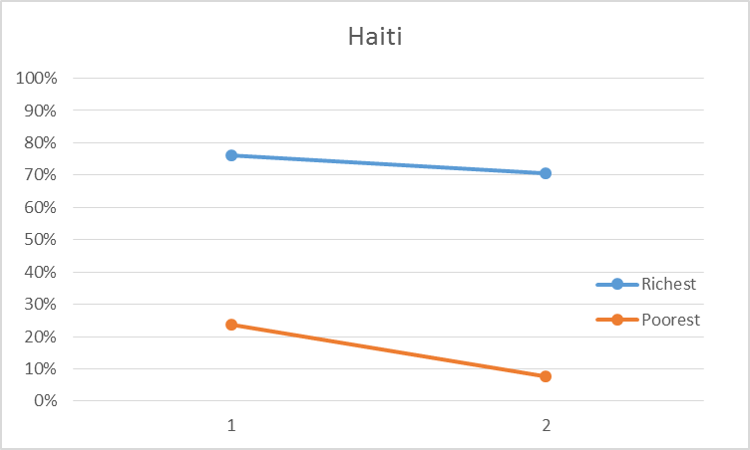
Skilled birth attendant
29/36 countries = 81% improved mean coverage

Slide 12
Best performing countries in terms of improving equity for six RM interventions
FPS | CPMT* | CPMO* | ANC1 | SBA
 |  |  |  | Benin
Bolivia | Bolivia | Bolivia | Bolivia
Cambodia | Cambodia | Cambodia | Cambodia
 | Egypt | Egypt | Egypt | Egypt
 | Haiti
Madagascar | Madagascar | Madagascar
Mozambique
Niger
 |  |  | Peru | Peru
 |  | Zambia
* Not presented in the graphs

Slide 13
A few conclusions
Equity may seem complicated to assess
  But it is not, if you understand the concept and the measures
Most countries studied managed to improve overall coverage
  Around 80% of them
In contrast, only a handful of countries showed improvement in equity for each indicator
  No more than 5 countries with very good improvement
  No more than 10 countries with some improvement
SBA was clearly the intervention that improved less in terms of equity

