Slide 1
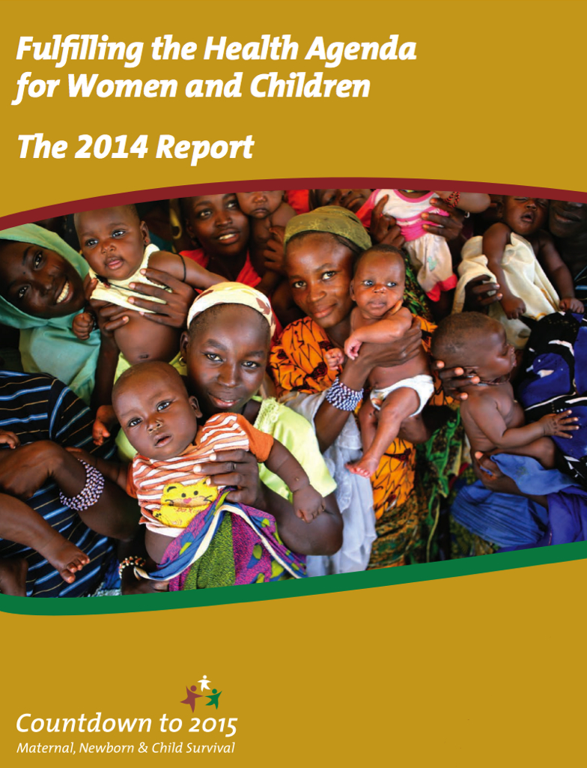
Countdown to 2015:
Congo
Add presenter name
Date
Event/location
Notes:
1
This presentation briefly explains the Countdown to 2015, the data from the 2014 Countdown profile for Congo, and a brief explanation of the benefits of holding a country Countdown.

Slide 2
Notes for the presenter on adapting this presentation
Personalise with photos, charts
Data presented are based on best available data up to mid-2014. When presenting, mention more recent studies or data. (2013 mortality on slide #18 added)
Select which slides are appropriate for the audience. For example: Slides are provided for each figure presented in the country profile; select from these (choosing all or a few depending on needs)
Sub-national data can be substituted as appropriate and available
Review the Speaker Notes, adapt according to your audience and purpose
Notes:
(This slide provides suggestions for the presenter. Additional slide presentations explaining global findings from Countdown 2014 and other specific aspects of Countdown are available on the Countdown website.)

Slide 3
Purpose of this presentation
To stimulate discussion about Congo country data, especially about progress, where we lag behind, and where there are opportunities to scale up
To provide some background about Countdown to 2015 for MNCH, the indicators, and data sources in the country profiles
To showcase the country profile as a tool for monitoring progress, sharing information and improving accountability
Notes:
Some government officials, local and international colleagues from Congo might know about the Countdown to 2015 for Maternal, Newborn and Child Health. The Countdown has been producing individual country profiles since 2005. This slide show is intended to stimulate discussion about country progress in Congo, using data from global data bases as of early 2014 and provided by Countdown.

Slide 4
Outline
Countdown to 2015: Background
Congo Countdown profile
Notes:
Part 1 will briefly describe the Countdown to 2015, and Part 2 will describe the Congo profile.

Slide 5
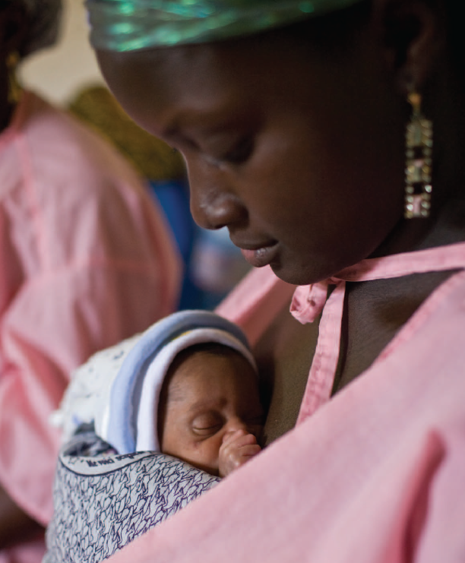

Part I
Countdown to 2015: Background

Slide 6
What is Countdown?
A global movement initiated in 2003 that tracks progress in maternal, newborn & child health in the 75 highest burden countries to promote action and accountability
Notes:
Countdown is a global movement begun in 2003 with the purpose of tracking progress in maternal, newborn & child health in the 75 highest burden countries, with the purpose of promoting action and accountability.

Slide 7
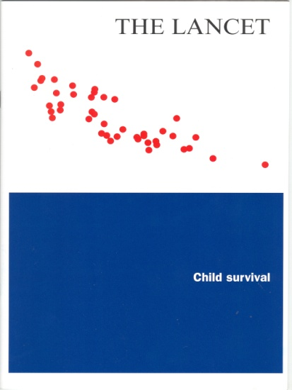
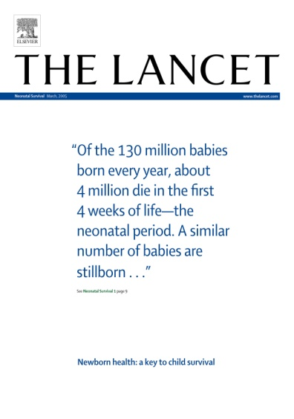
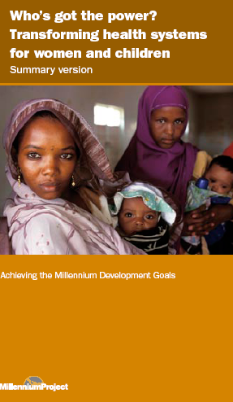
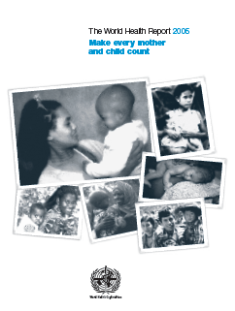


Countdown origins
2003 Lancet Child Survival Series
2005 Lancet Neonatal Series
A refrain from the United Nations, NGOs,
and civil society:
  Effective interventions are available
  Coverage is unacceptably low and inequitable
  We need to MAKE NOISE
Notes:
The Countdown originated from a series of articles in The Lancet showing lack of progress in reducing child mortality, in spite of availability of evidence-based interventions. The articles resulted in a call for intensified efforts for child and newborn survival. Soon after, the Countdown added maternal health to its mandate and now covers the continuum of care for RMNCH.

Slide 8
Countdown aims
To disseminate the best and most recent information on country-level progress
To take stock of progress and propose new actions
To hold governments, partners and donors accountable wherever progress is lacking
Notes:
Countdown has three key aims: Disseminating the most recent information on country-level progress, analyzing this progress and proposing relevant action, and increasing accountability by all partners.

Slide 9
What does Countdown do?
Analyze country-level coverage and trends for interventions proven to reduce maternal, newborn and child mortality
Track indicators for determinants of coverage (policies and health system strength; financial flows; equity)
Identify knowledge and data gaps across the RMNCH continuum of care
Conduct research and analysis
Support country-level Countdowns
Produce materials, organize global conferences and develop web site to share findings
Notes:
Countdown analyzes coverage and trends for proven interventions. It also tracks indicators for policies, health systems, and financial flows, as well as for equity. Countdown identifies data gaps across the continuum of care for RMNCH and contributes to solutions by undertaking research and analysis. Findings are shared through publications, conferences, and the Countdown website. Now, Countdown is giving high priority to supporting countries in undertaking their own Country Countdown processes.

Slide 10
Countdown:
Promoting accountability for action
Country profiles
Analysis
& events
Evidence-based planning, budgeting & programs
National Level
2015
Global Level
Notes:
Countdown efforts begin with the production of country profiles based on global data bases. Global analysis of the data and trends is useful, but national level review and discussion can lead to additional evidence-based action.

Slide 11
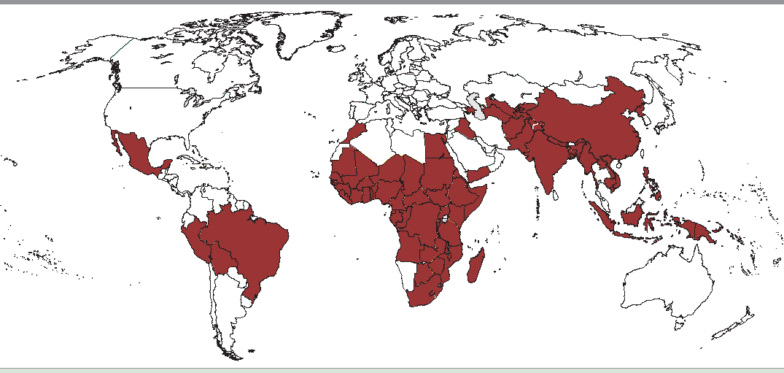
Where is Countdown?
75 countries that together account for > 95% of maternal and child deaths worldwide
Notes:
Countdown covers countries where rates of mortality or numbers of deaths are high. The 75 Countdown countries account for more than 95% of all maternal and child deaths worldwide.

Slide 12

Who is Countdown?
Individuals: scientists/academics, policymakers, public health workers, communications experts, teachers…
Governments:
  RMNCH policymakers, members of Parliament…
Organizations:
NGOs, UN agencies,
health care professional associations, donors,
medical journals…
Notes:
Countdown partners include organizations and individuals from a large number of disciplines and includes governments, UN agencies, NGOs, development partners, donors, and representatives of civil society.

Slide 13
Countdown moving forward
Four streams of work to promote accountability,
2011-2015
  Responsive to global accountability frameworks
  -Annual reporting on 11 indicators for the Commission on Information and Accountability for Women’s and Children’s Health (COIA)
  -Contribute to follow-up of A Promise Renewed/Call to Action
  Production of country profiles/report and global event(s)
  Cross-cutting analyses
  Country-level engagement
Notes:
The future work of the Countdown is well coordinated with other efforts to stimulate action and accountability to meet both global and national commitments. Most important is Countdown’s engagement in strengthening monitoring at the country level.

Slide 14
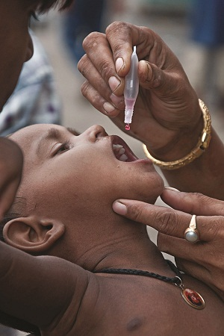
Part 2
Congo Countdown country profile
Main findings
Notes:
Countdown’s global database provides a useful country-level snapshot.

Slide 15
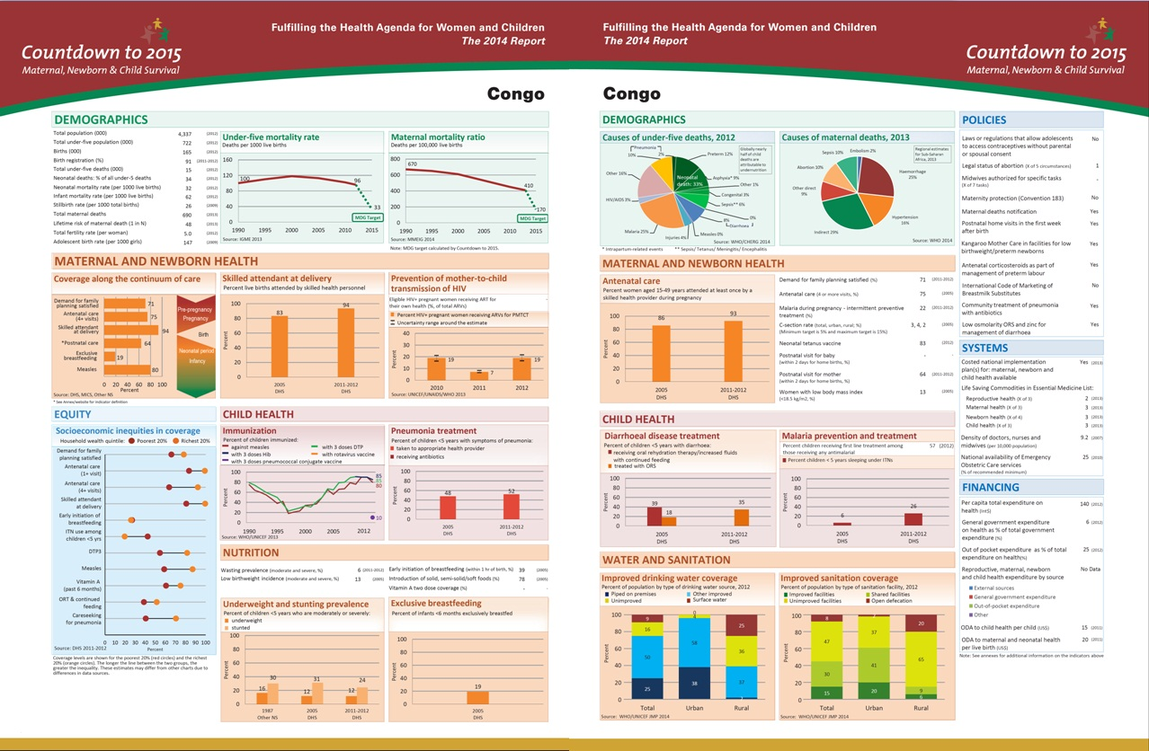
Notes:
The 2014 Countdown profile for Congo has a wide range of data on maternal, newborn and child health. It includes data for coverage of effective interventions for which there is internationally comparable data, where possible, including trend data. In the 2014 Countdown profiles, and in this presentation, all data are the most recent available as of the time the profiles were developed in early 2014, with most data from the last nationally representative household survey. In some cases, more recent data have been released since the profile was published or this presentation was developed.

Slide 16
Range of data on the profile
What does Countdown monitor?
Progress in coverage for critical interventions across reproductive, maternal, newborn & child health continuum of care
Health Systems and Policies – important context for assessing coverage gains
Financial flows to reproductive, maternal, newborn and child health
Equity in intervention coverage
Notes:
The profile includes coverage data and trends in coverage for critical interventions across the continuum of care. It also includes selected information on Health Systems and Policies and Financial Flows. Data on the equity of intervention coverage is also included on the profile, when available.
(You might choose to add 4 additional slides on Equity which have been provided at the end of this presentation and noted as optional.)

Slide 17
Sources of data
The national-level profile uses data from global databases:
Population-based household surveys
  UNICEF-supported MICS
  USAID-supported DHS
  Other national-level household surveys (MIS, RHS and others)
  Provide disaggregated data - by household wealth, urban-rural residence, gender, educational attainment and geographic location
Interagency adjusted estimates
  U5MR, MMR, immunization, water/sanitation
Other data sources (e.g. administrative data, country reports on policy and systems indicators, country health accounts, and global reporting on external resource flows etc.)
Notes:
All data comes from global data bases. Most come from population based household surveys, some are interagency estimates. (Please note that these interagency estimates of maternal and child mortality are adjusted in order to make them statistically comparable across countries. They may therefore differ from Congo’s official mortality statistics.)
Other data sources are listed here and include country reports.

Slide 18
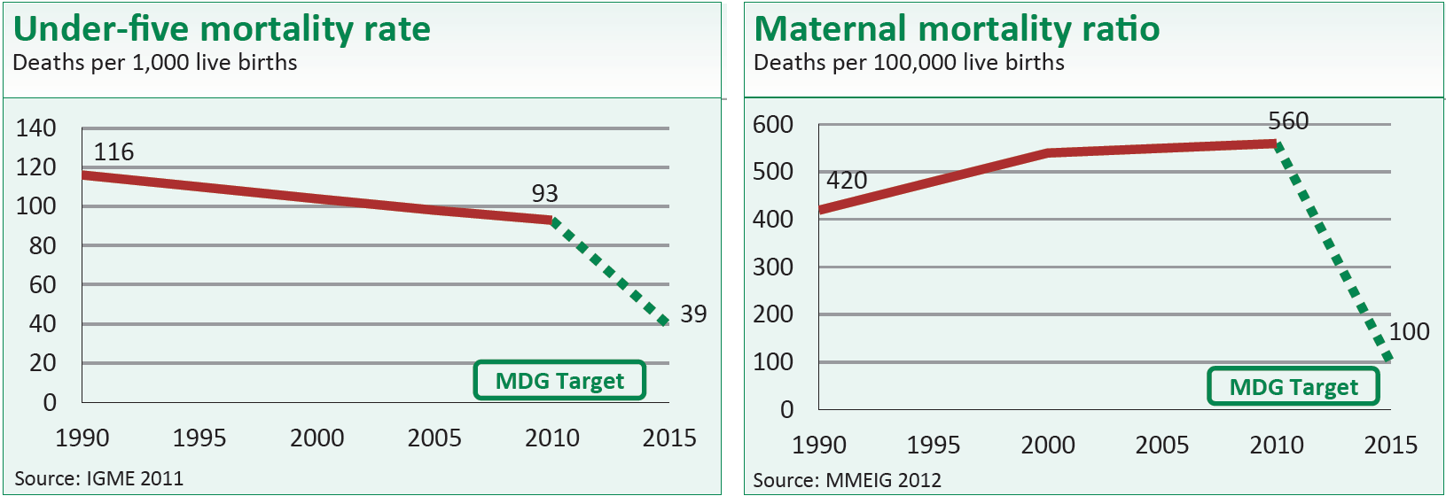
Mortality
Mortality data through 2010:
2011 child mortality data was released in late 2012:
Under-five mortality rate (U5MR)= 99 deaths per 1000 live births
Infant mortality rate (IMR) = 64 deaths per 1000 live births
Neonatal mortality rate (NMR) = 32 deaths per 1000 live births
Notes:
The Congo 2010 Under—five child mortality rate is decreasing very slowly and the Maternal mortality ratio not decreasing at all. Both rates remain high. Newer UN estimates show an Under-five mortality rate of 99 for 2011.
(Note: Updated 2011 child mortality data from “The UN Inter-agency Group for Child Mortality Estimation, 2012”)

Slide 19
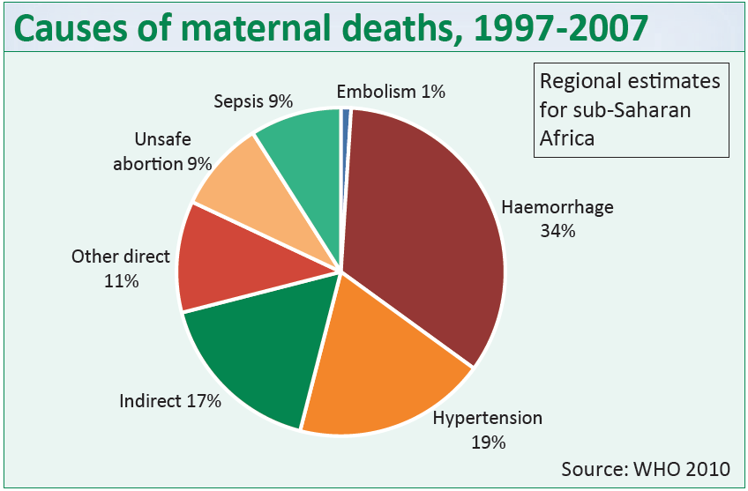
Cause of death
Leading direct causes:
Haemorrhage – 34%
Hypertension – 19%
Unsafe abortion – 9%
Sepsis – 9%
  Understanding the cause of death distribution is important for program development and monitoring
Notes:
The Causes of maternal deaths for sub-Saharan Africa, including Congo, are shown here.
(Note to speaker: these are regional estimates, not country specific)

Slide 20
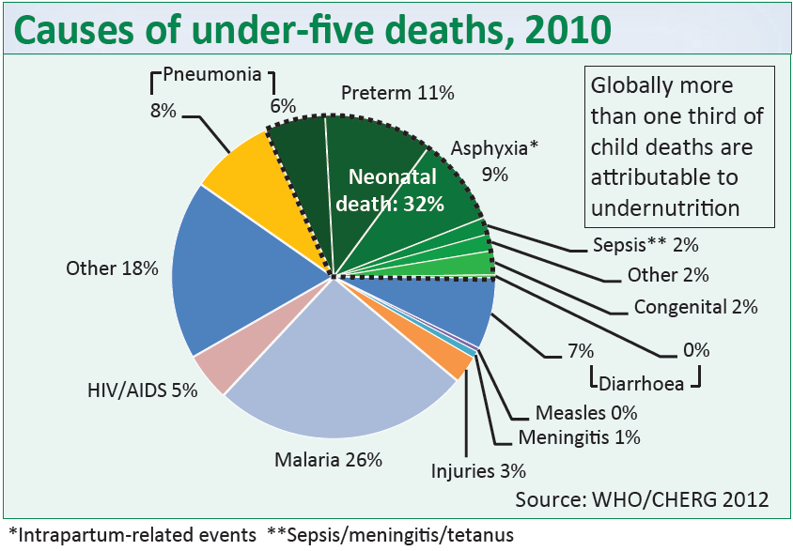
Cause of death
Leading causes:
Neonatal – 32%
Malaria – 26%
Pneumonia – 8% Diarrhoea – 7%
HIV/AIDS – 5%
  Undernutrition is a major underlying cause of child deaths
Notes:
Some 32% of child deaths occur in the neonatal period. Most of these can be prevented. Post-neonatal deaths can, also, mostly be prevented and come mainly from Malaria, Pneumonia, Diarrhoea, and HIV/AIDS.

Slide 21
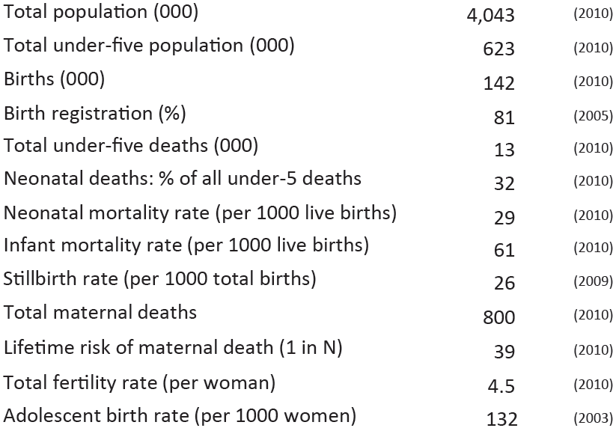
Demographics
Notes:
The profile also shows key demographic data for the country, as of the time of publication.
(Please note that updated infant and neonatal mortality rates as of 2011 were recently published and are on an earlier slide. All figures included here were the most recent available at the time the Countdown profile was last produced.)

Slide 22
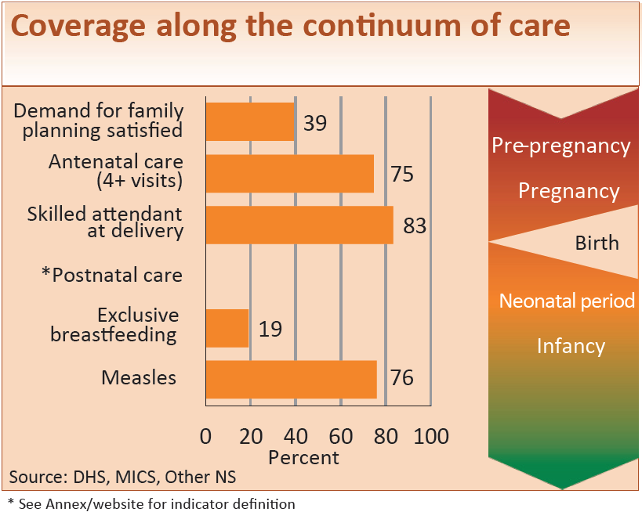
Variable coverage along the continuum of care
Notes:
Coverage varies greatly along the continuum of care. It’s useful to consider what delivery strategies are used to deliver these interventions and how to overcome barriers to delivery or utilization of key services.

Slide 23
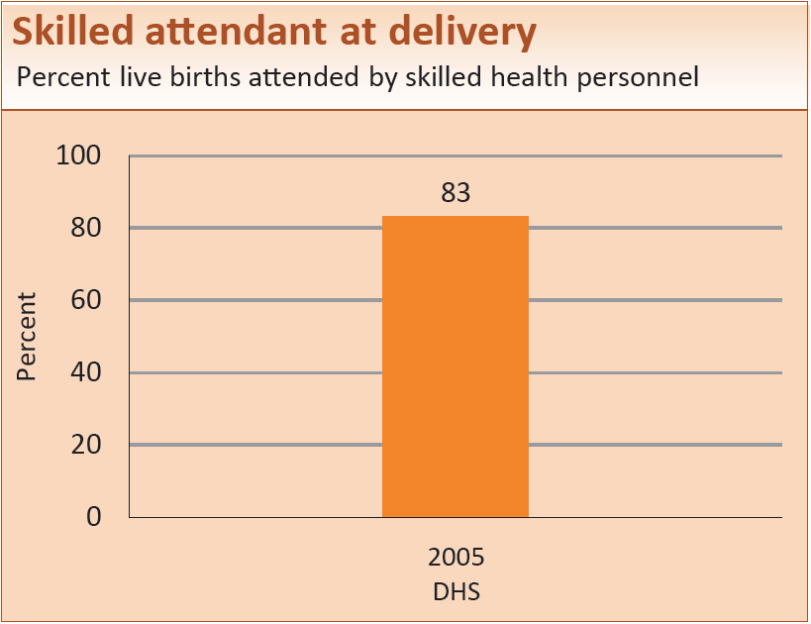
Maternal and newborn health
Notes:
Coverage of Skilled attendant at delivery were high in 2005, but it’s important to consider who still lacks access and if quality of care issues also need to be addressed.

Slide 24
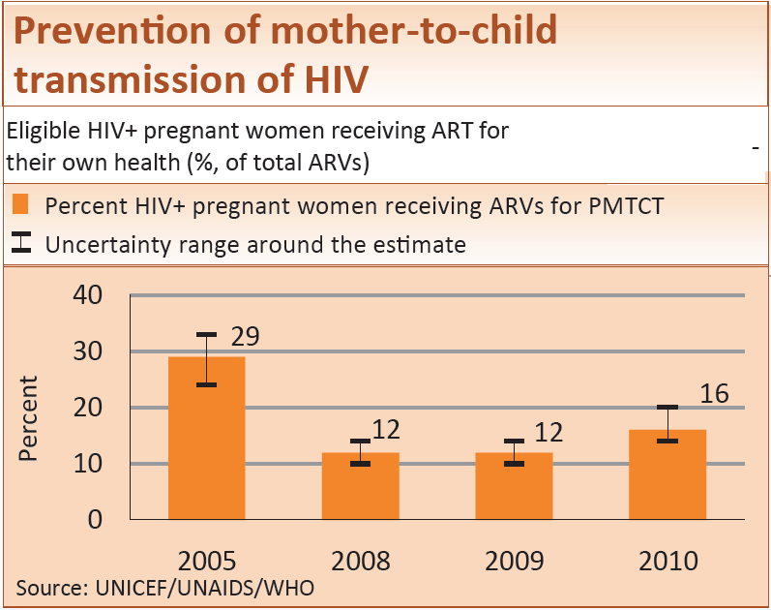
Maternal and newborn health
Notes:
PMTCT coverage is estimated at 16%.

Slide 25
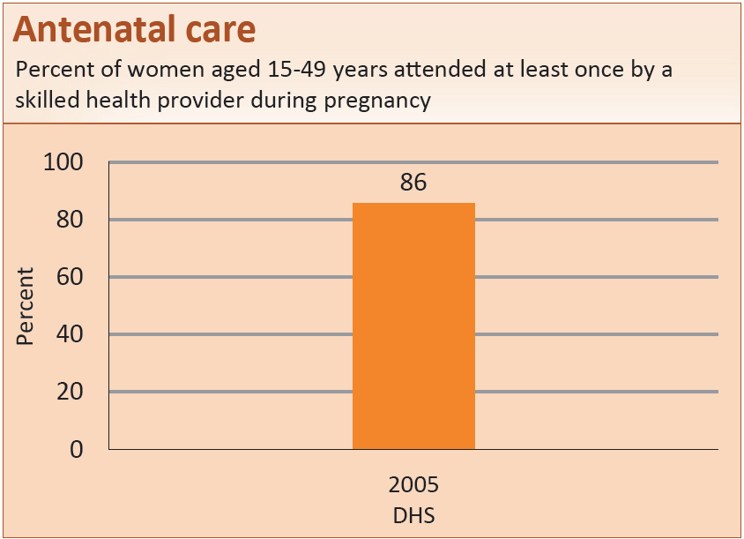
Maternal and newborn health
Notes:
86% of women attended Antenatal care with a skilled health provider at least once during pregnancy. Fewer women are attending the necessary 4 visits, as shown on the next slide. Quality of care for antenatal care also needs to be considered.

Slide 26
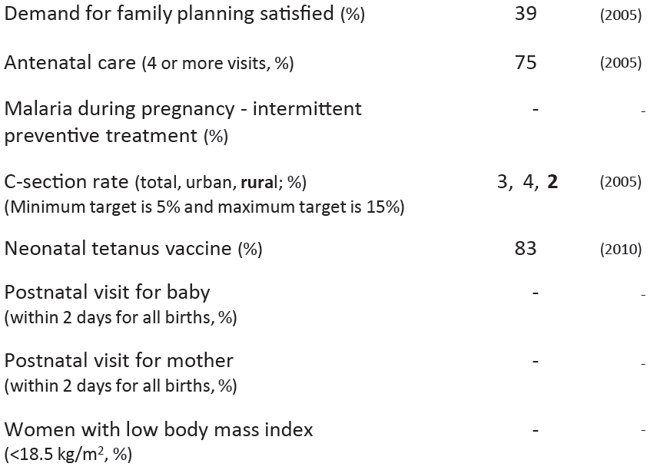
Other maternal and newborn health indicators
Notes:
As seen here, there is still room for improvement for a number of other maternal and newborn health indicators. C-Section rates are still below the minimum needed to save women’s lives. Data is not available for Postnatal visits for mom or for baby or for Women with low body mass.

Slide 27
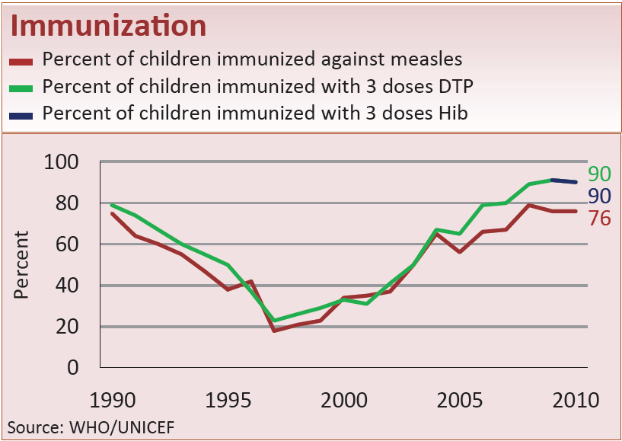
Child health
Notes:
Congo’s Immunization coverage is high except for measles.

Slide 28
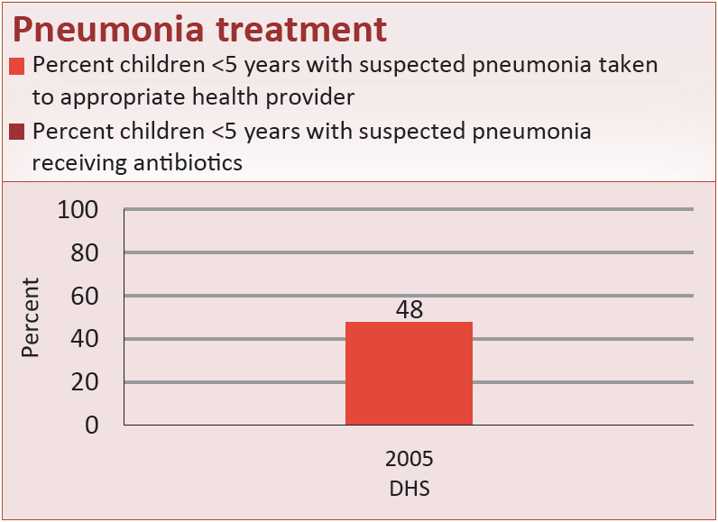
Child health
Notes:
In 2005 some 48% of children with suspected pneumonia were taken to an appropriate health provider for treatment. Data on those receiving antibiotics is not available.

Slide 29
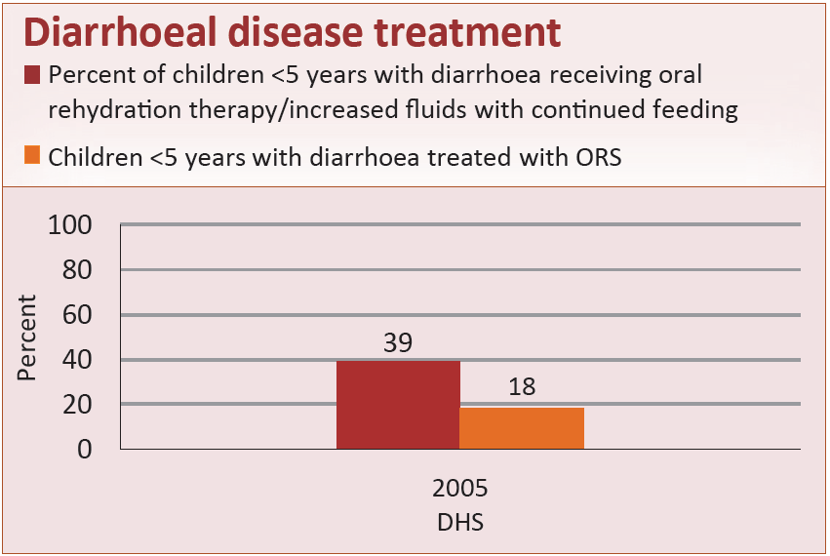
Child health
Notes:
Only 18% of children with diarrhoea were being treated with ORS in 2005. 39% were receiving oral rehydration therapy or increased fluids and continued feeding.

Slide 30
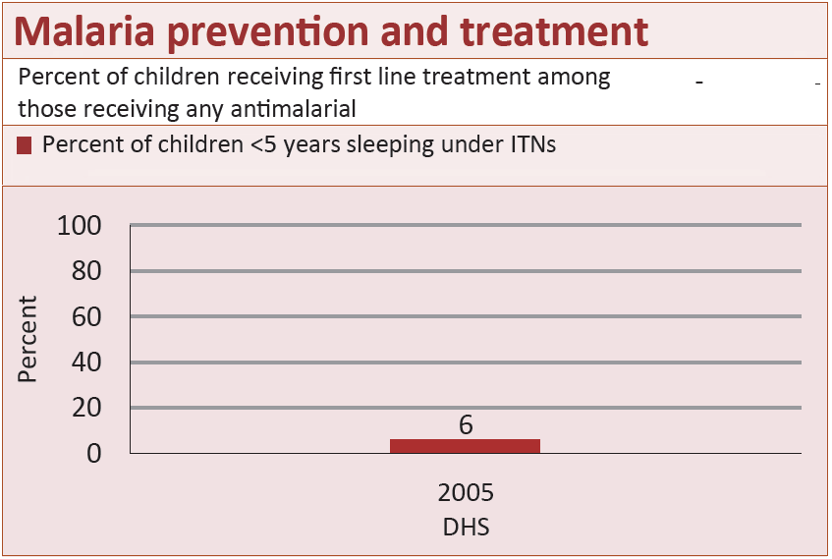
Child health
Notes:
ITN use was only 6% in 2005.

Slide 31
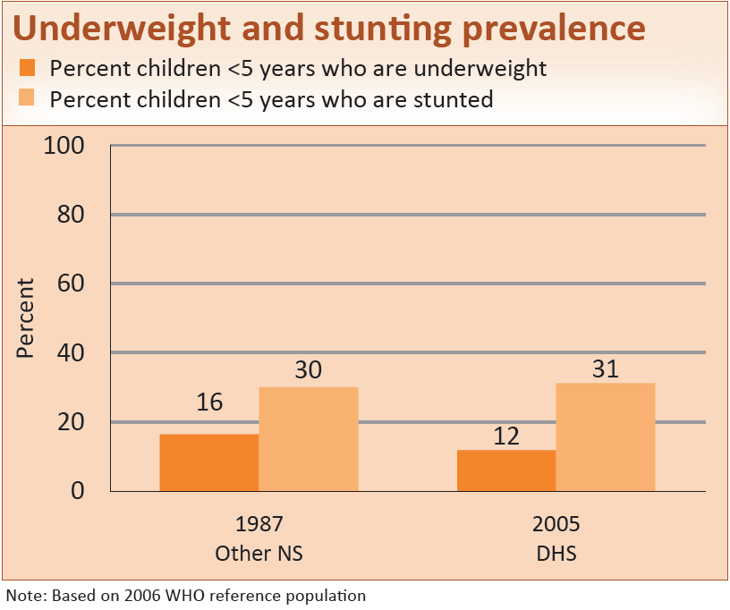
Child health
Notes:
Underweight and stunting rates are high.

Slide 32
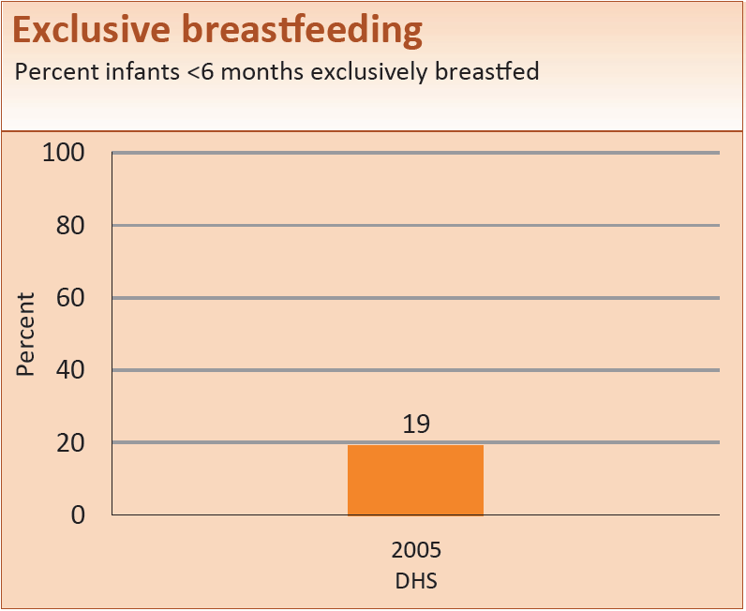
Child health
Notes:
The Exclusive breastfeeding rate was only 19% in 2005.

Slide 33
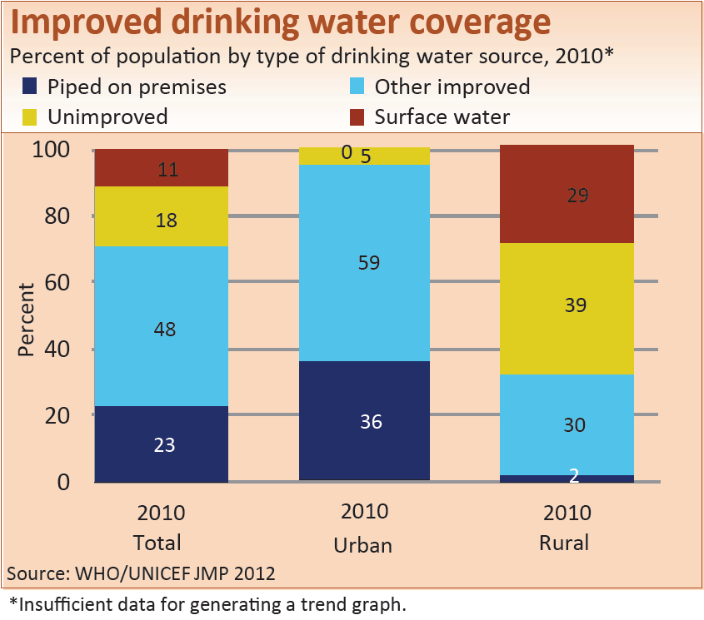
Water and sanitation
Notes:
Around 68% of rural residents are without Improved drinking water.

Slide 34
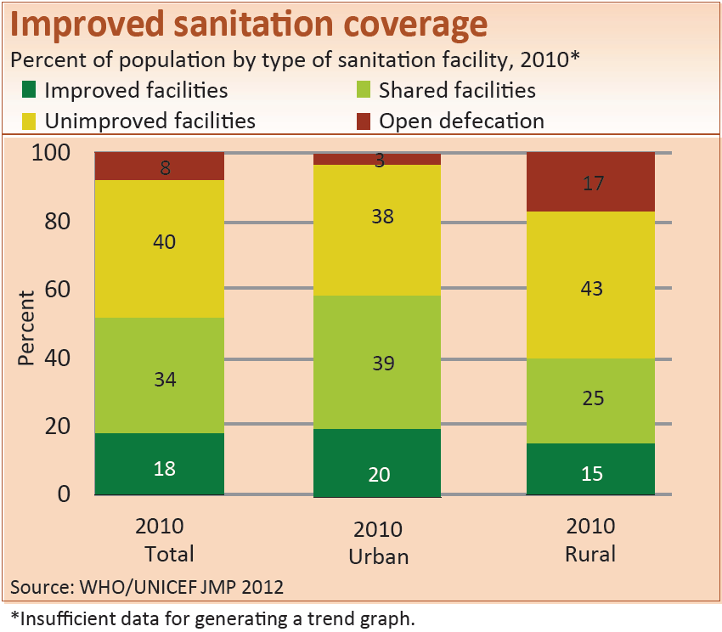
Water and sanitation
Notes:
48% of the population are using unimproved facilities. In rural areas 17% still practice open defecation.

Slide 35
MNCH policies
NO - Maternity protection in accordance with Convention 183
NO - Specific notifications of maternal deaths
YES - Midwifery personnel authorized to administer core set of life saving interventions
NO - International Code of Marketing of Breastmilk Substitutes
NO - Postnatal home visits in first week of life
NO - Community treatment of pneumonia with antibiotics
YES - Low osmolarity ORS and zinc for diarrhoea management
- Rotavirus vaccine
PARTIAL - Pneumococcal vaccine
Notes:
The Congo has fully adopted only a few of the globally recommended policies that are tracked by Countdown. Adopting these policies and implementing them at scale can contribute to improved coverage for life saving interventions.

Slide 36
Systems and financing for MNCH
Costed national implementation plans for MNCH: Yes
Density of doctors, nurses and midwives (per 10,000 population): 9.2 (2007)
National availability of EmOC services: - -
(% of recommended minimum)
Per capita total expenditure on health (Int$): $104 (2010)
Government spending on health: 5% (2010)
(as % of total govt spending)
Out-of-pocket spending on health: 53% (2010)
(as % of total health spending)
Official development assistance to child health per child (US$): $6 (2009)
Official development assistance to maternal and newborn health per live birth (US$): $6 (2009)
Notes:
These indicators for Systems and financing give a limited, but useful, picture of system strengths and weaknesses.

Slide 37
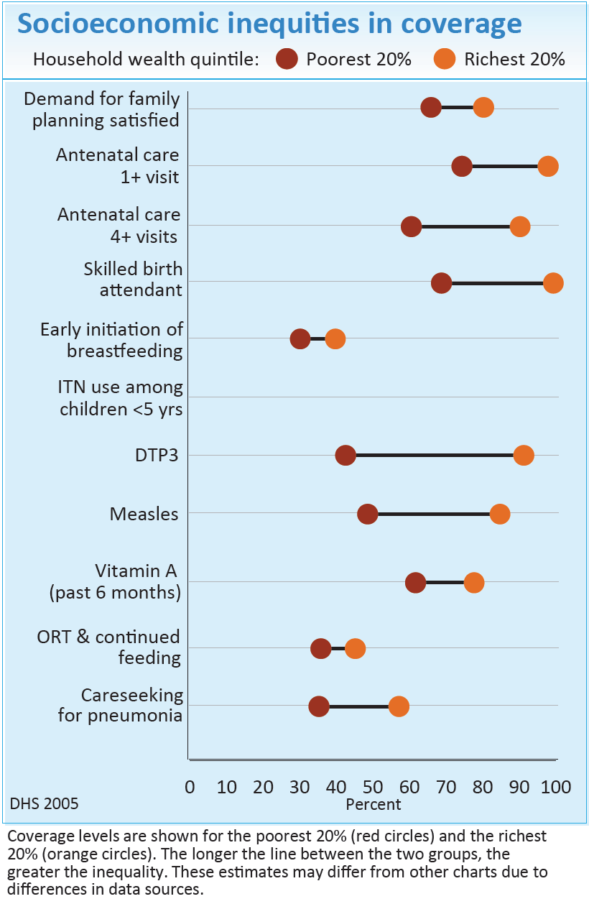
Who is left behind?
Congo
The wide bars for many indicators show important inequalities in coverage.
Inequality is greatest for immunizations.
ORT & continued feeding and early initiation of breastfeeding show much smaller gaps in coverage.
Notes:
This slide shows coverage levels for the poorest and richest households for a range of interventions along the continuum of care. The poorest 20% are represented by the red dot. The wealthiest 20% are represented by the orange dot. The longer the line between the two groups, the greater the inequality. Inequality is greatest for Immunizations, both DTP3 and Measles. Other interventions such as Skilled birth attendant, Antenatal care, and Careseeking for pneumonia also show large gaps in coverage. Only ORT & continued feeding and Early initiation of breastfeeding show much smaller gaps in coverage.
(These figures might differ from other charts due to differences in data sources.)
(Note: Additional Equity slides for Congo are included as optional at the end of this presentation and are also available on the Countdown website.)

Slide 38
Thank you!

Slide 39
Optional additional slides
Equity profiles
Congo
Notes:
The following 4 supplementary slides contain figures showing: (1) the coverage levels in the poorest and richest quintiles for selected interventions along the continuum of care; (2) coverage levels in the five wealth quintiles for these interventions; (3) the co-coverage of health interventions: percentage of children aged 1–4 years according to the number of key child-survival interventions received, by wealth quintile; (4) the Composite coverage index of selected interventions and corresponding coverage gap (how much is needed to reach universal coverage), by wealth quintile.

Slide 40
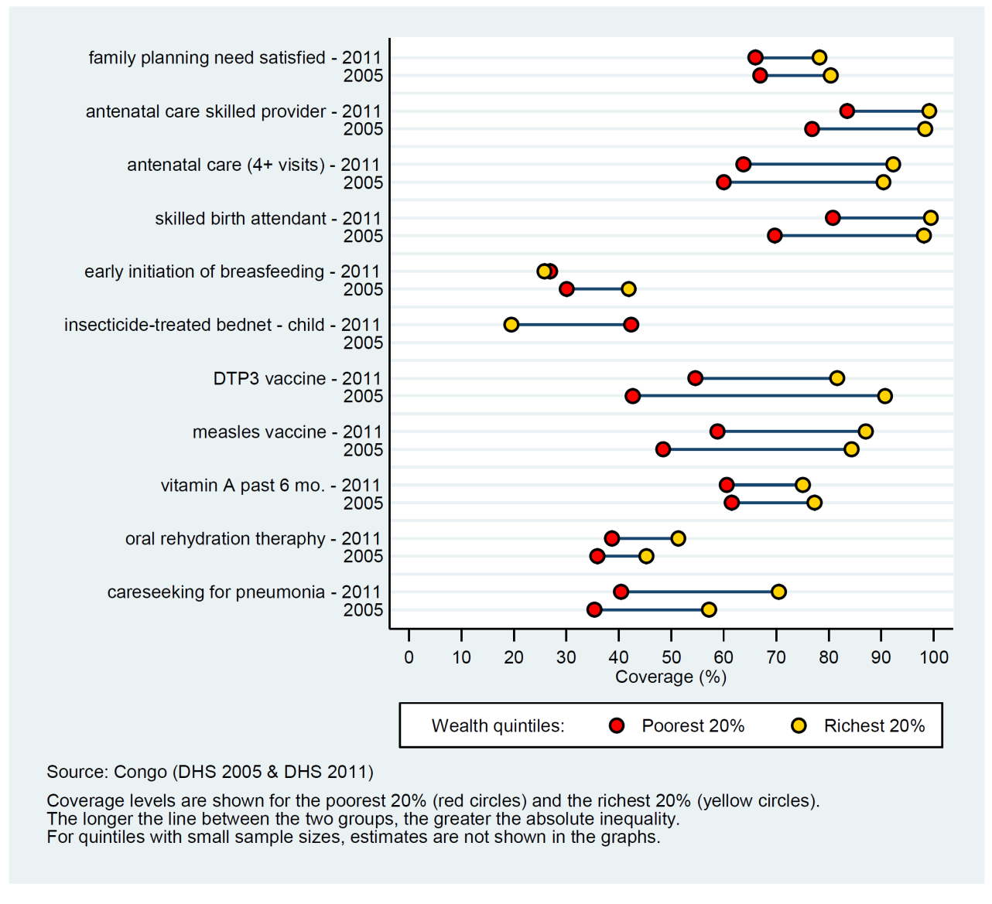
Coverage levels in poorest and richest quintiles
Notes:
This slide shows coverage levels for the poorest 20%, or first quintile of wealth (Q1) and for the richest 20%, or fifth quintile of wealth (Q5). Red dots show coverage for the poorest (Q1) and yellow dots for the richest (Q5). Wider bars mean more inequality in absolute terms for that intervention. Narrower bars mean less inequality in absolute terms for that intervention.
Interventions that require a functional health system, such as skilled birth attendant, are generally more inequitable.
(Note: This slide is repeating the data on slide 37 but with a different layout.)

Slide 41
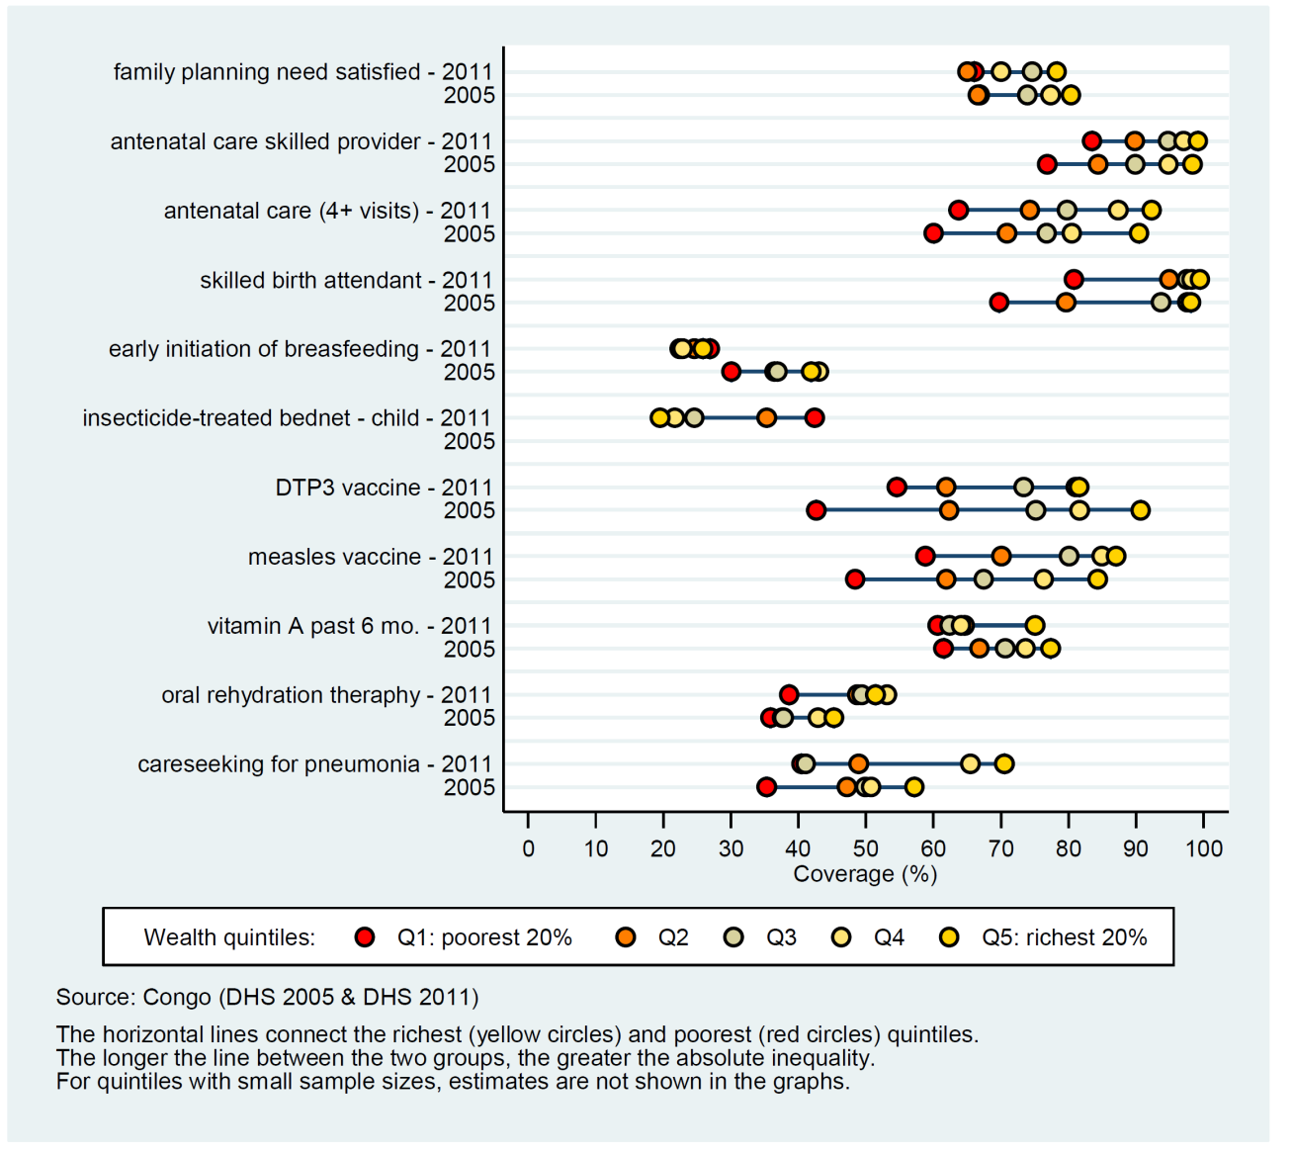
Coverage levels in the 5 wealth quintiles
Notes:
This slide shows coverage levels in the five wealth quintiles… from the poorest 20% to the richest 20%. Red dots show coverage for the poorest (Q1) and yellow dots for the richest (Q5); the other colors represent the intermediate quintiles. Most often, coverage is lowest for the poorest (Q1) and increases steadily with wealth. In rare cases, the intervention shows an inverted pattern, decreasing coverage with wealth. Sometimes, coverage does not increase linearly with wealth and the quintiles are not in the expected order.

Slide 42
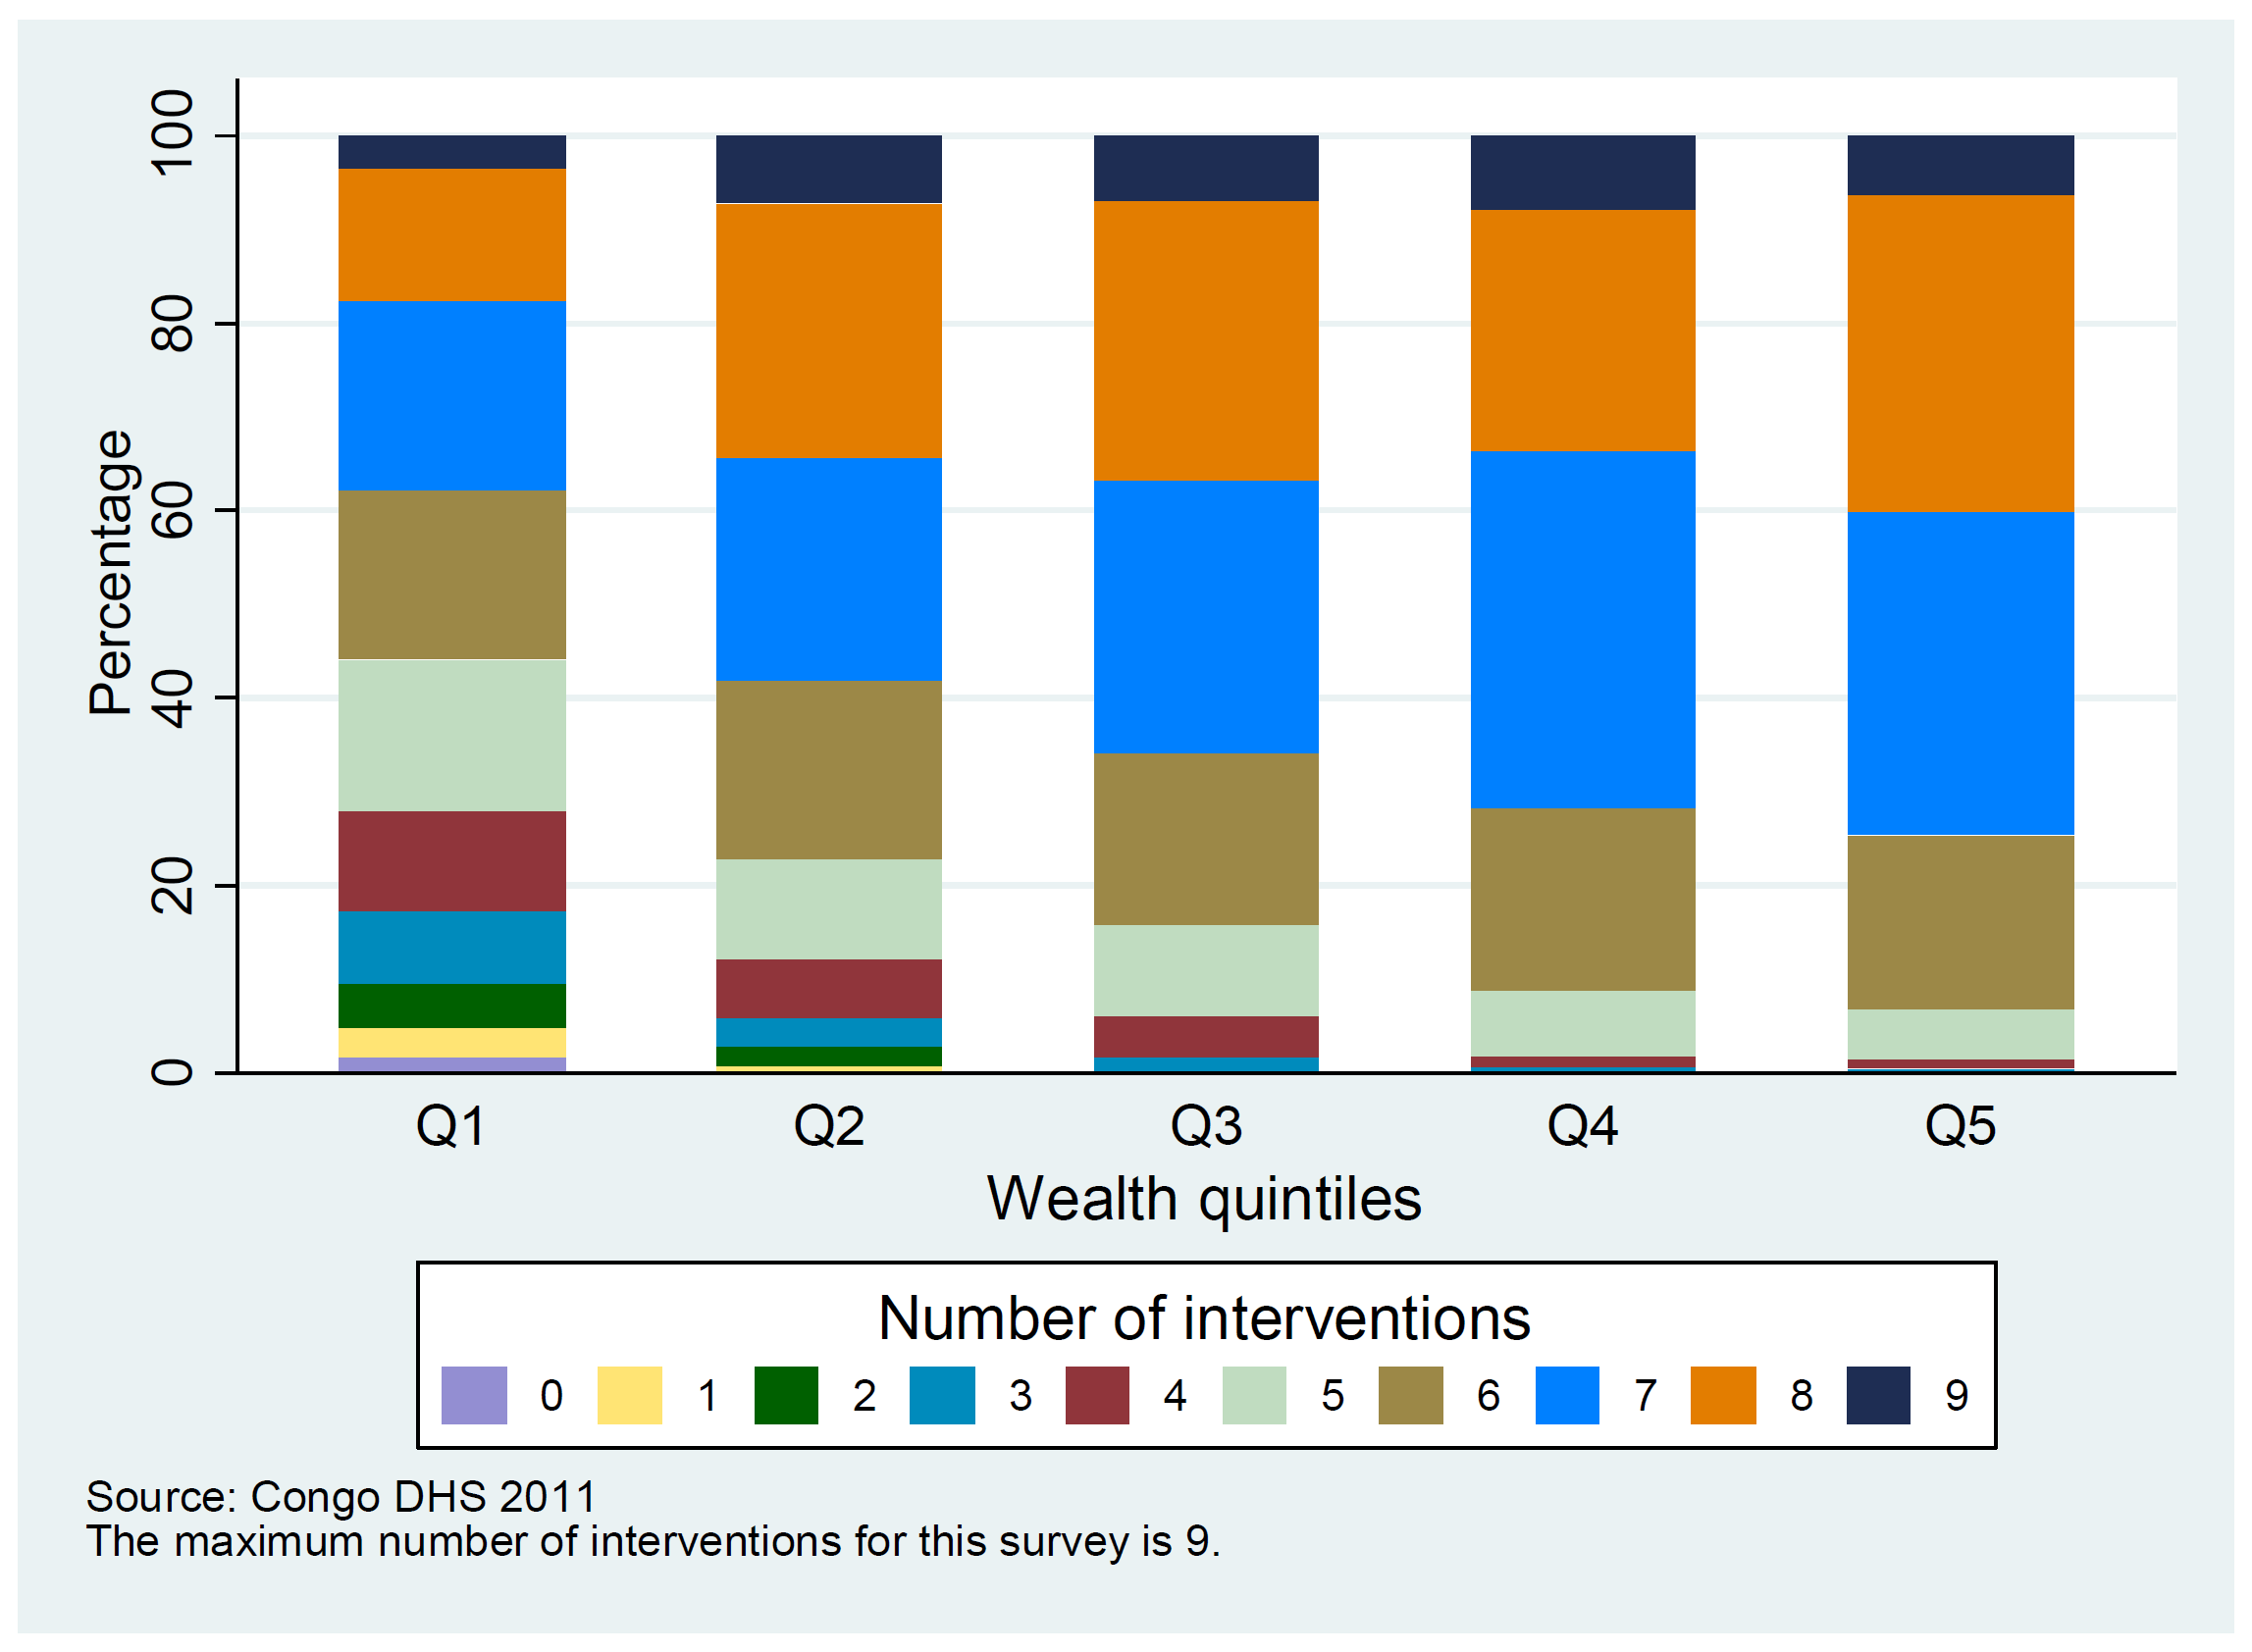
Co-coverage of health interventions
Notes:
This slide shows co-coverage of health interventions: percentage of children aged 1–4 years according to the number of key child-survival interventions received according to wealth quintile. The colored bands show the proportion of children in each wealth quintile that received a given number of interventions.
Interventions taken into account for the co-coverage analysis:
Antenatal care (1+ visits with skilled provider), mother immunized against tetanus, skilled birth attendant, BCG immunization, 3 doses of DTP, measles immunization, child received vitamin A in the past 6 months, child slept under insecticide-treated bednet the previous night (only for countries with endemic malaria).

Slide 43
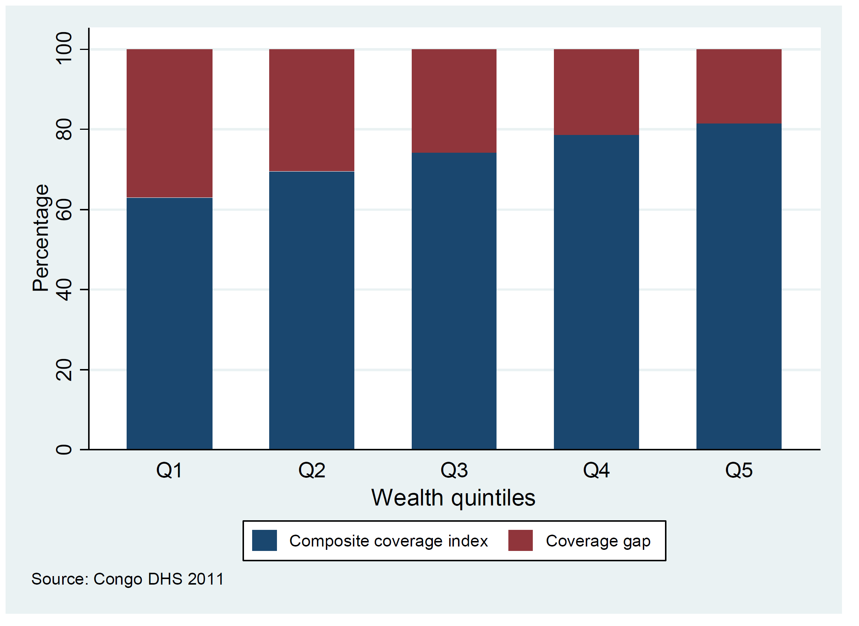
Composite coverage and coverage gap
Notes:
This slide shows the composite coverage of selected interventions and the corresponding coverage gap (how much is needed to reach universal coverage), by wealth quintile. The red area shows the coverage gap or which proportion of the population needs to be reached before universal coverage is attained in each wealth quintile. The blue area shows the composite coverage index for each of the five wealth quintiles. Most often we see an increasing trend towards the richest.
(Composite coverage is a weighted mean of eight interventions selected to cover four domains: contraception, pregnancy and delivery, immunization and care of common childhood diseases. It was created to present an overall picture of intervention coverage for a given country.)
(Note: 𝐶𝐶𝐼=1⁄4 (𝐹𝑃𝑆+(𝑆𝐵𝐴+𝐴𝑁𝐶𝑆)/2+(2𝐷𝑃𝑇3+𝑀𝑆𝐿+𝐵𝐶𝐺)/4+(𝑂𝑅𝑇+𝐶𝑃𝑁𝑀)/2).
FPS is family planning needs satisfied, SBA is skilled birth attendant, ANCS is antenatal care with skilled provider, DPT3 is three doses of Diphtheria, Pertussis, and Tetanus (DPT) vaccine, MSL is measles vaccination, ORT is oral rehydration therapy for children with diarrhea, and CPNM is care seeking for pneumonia.)

