Slide 1

The Health of Brazilian mothers and children,
1970-2010

Slide 2
The situation in the 1970s
Military dictatorship
Rapid economic growth
One of world’s highest income concentration
IMR > 100
MMR > 150
Three tiered health care:
  private / social security / charity

Slide 3
Underlying trends
Urbanization
  56% (1970) → 83% (2010)
Marked drop in fertility
  TFR 4.8 (1960s) →1.8 (2000s)
  CPR 67% (1986) → 79% (2007)
Increased coverage
  ANC: 75% (1981) → 99% (2007)
  Hospital delivery: 80% (1981) → 98% (2007)

Slide 4
Reduction in socioeconomic inequities

Slide 6
Skilled birth attendance by income quintiles, 1996-2006
Barros F et al, AJPH (in press)
=

Slide 7
Skilled birth attendance:
Inequity gaps, 1996-2006
Barros F et al, AJPH (in press)
Source: New analyses

Slide 8
Inequity gaps in coverage,
1996-2006
Barros F et al, AJPH (in press)
Source: New analyses

Slide 9
Progress against infant and under-five mortality

Slide 10
Infant mortality trends
Annual rates of
decline
1930-1970 ≈ 1%
1970s = 3.2%
1980s = 5.5%
1990s = 5.5%
2000s = 4.4%

Slide 11
Poor-rich gaps in under-five
mortality, 1991 and 2001-2
Barros F et al, AJPH (in press)
Source: new analyses.

Slide 12
Infant deaths by cause
1990-2007
Barros F et al, AJPH (in press)

Slide 13
Infant deaths by cause
1990-2007
Barros F et al, AJPH (in press)

Slide 14
Undernutrition prevalence
1989-2006
Monteiro CA et al, Bull WHO (2010)

Slide 15
Child nutrition: stunting by income
Monteiro CA et al, Bull WHO (2010)

Slide 16
Median duration of any breastfeeding (months)
National surveys (current status analyses)

Slide 17
Any success in reducing maternal mortality?

Slide 18
Maternal mortality trends

Slide 19
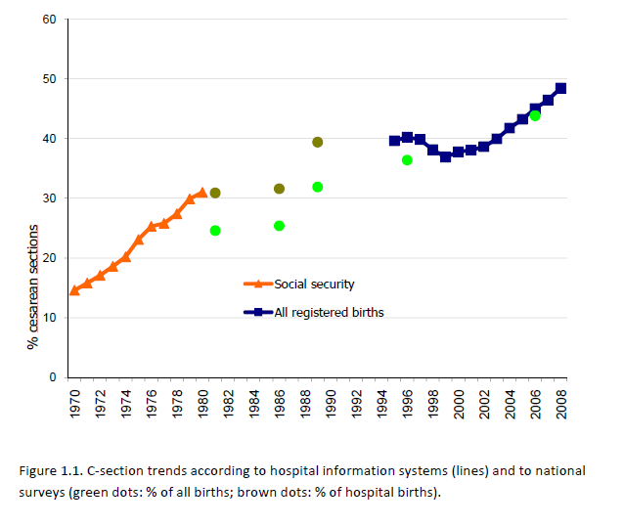
C-sections: time trends

Slide 20
What about maternal mortality?
Why does mortality seem to have stabilized at relatively high levels, in spite of increased access and coverage to antenatal, delivery and post-partum care?
  Improved reporting?
  Poor quality of services?
  Too many C-sections?

Slide 21
How to explain the observed improvements?

Slide 22
MDG1: Reduce underweight by 1/2
  1989: 5.6% -- 2006/7: 2.2%
MDG4: Reduce underfive mortality by 2/3
  1990: 57 -- 2007: 20
MDG5: Reduce maternal mortality by 3/4
  Unlikely to be reached

Slide 23
Reasons for Brazil’s progress
Socioeconomic and demographic factors
  Moderate economic growth
  Reduction of socioeconomic inequalities (>2000)
  Improved maternal education
  Sharp decline in fertility
  Urbanization
Non health-sector interventions
  Huge conditional cash transfer program
  Marked improvement in water supply
  Rural social security

Slide 24
Reasons for Brazil’s progress
Health sector interventions
  Vertical programs in the 1980s-1990s
    Oral rehydration
    Immunizations
    Breastfeeding promotion
  Creation of a national health system in 1989
  Strong popular participation at all levels of the NHS
  Family health program with geographical targeting
  High visibility of child health

Slide 25
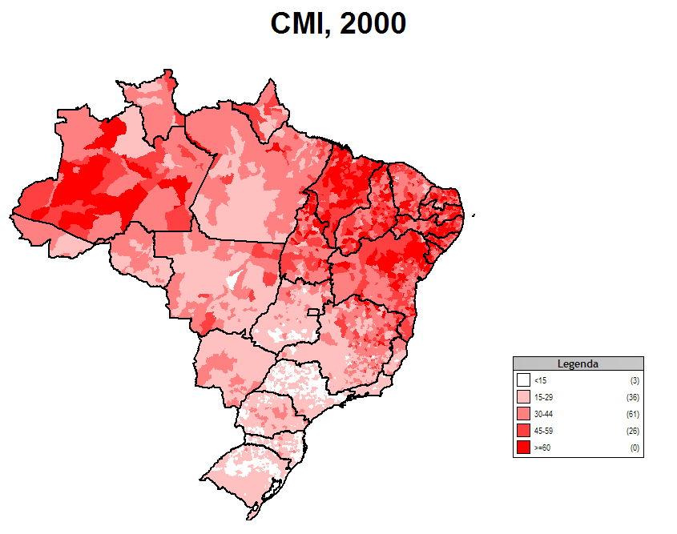
Infant mortality by region
Infant mortality rate, 2000
Infant mortality is highest in the Northeast and North
Cedeplar/UNDP, Brazil

Slide 26
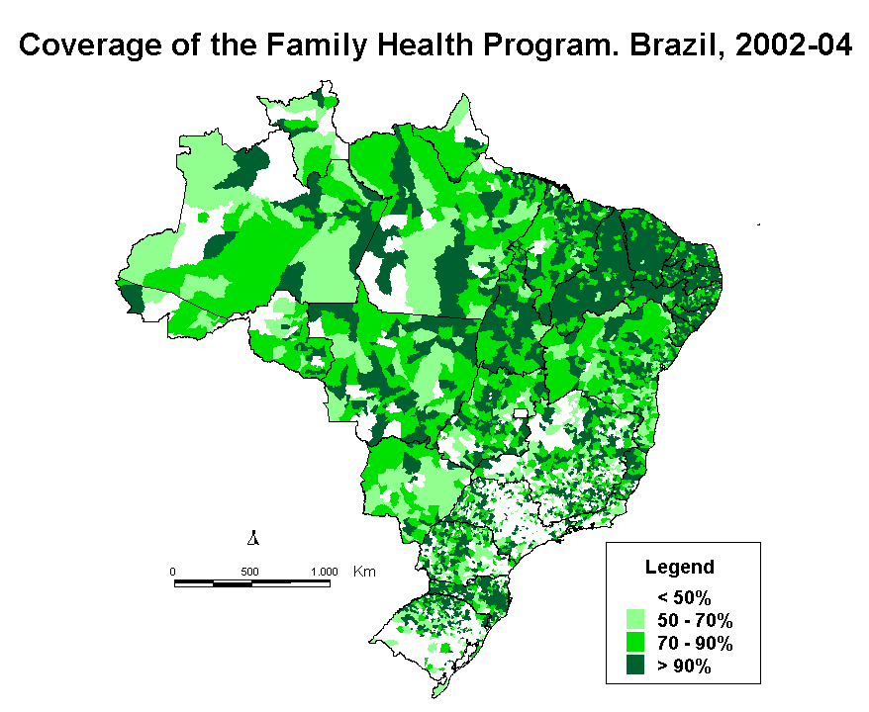
Family health program
Brazil MOH

Slide 27
But most and foremost:
Reducing inequities of all types is a central component of governmental policies

