Slide 1


Caring for sick children in the community:
Experiences from Malawi
Humphreys Nsona
IMCI Unit

Slide 2
Outline of the presentation
Rationale for community case management of childhood illness (CCM) in Malawi
Characteristics of the approach
Status of implementation
Results of quality of care assessment
What has worked and tackling challenges

Slide 3
Progress in improving child survival, Malawi

Slide 4
Rationale for CCM in Malawi
30-35% of the population lives more than 8 km from a health facility
Coverage of treatment for pneumonia (30%), malaria (25%) and diarrhoea (27%) - this is too low
10,451 Health Surveillance Assistants are part of the health workforce - approximately 1:1000 population
The national Essential Health Package includes community-based treatment of common childhood conditions (CCM)

Slide 5
Estimates of preventable deaths in Malawi by 2011 – Lives Saved Tool (LiST)

Slide 6
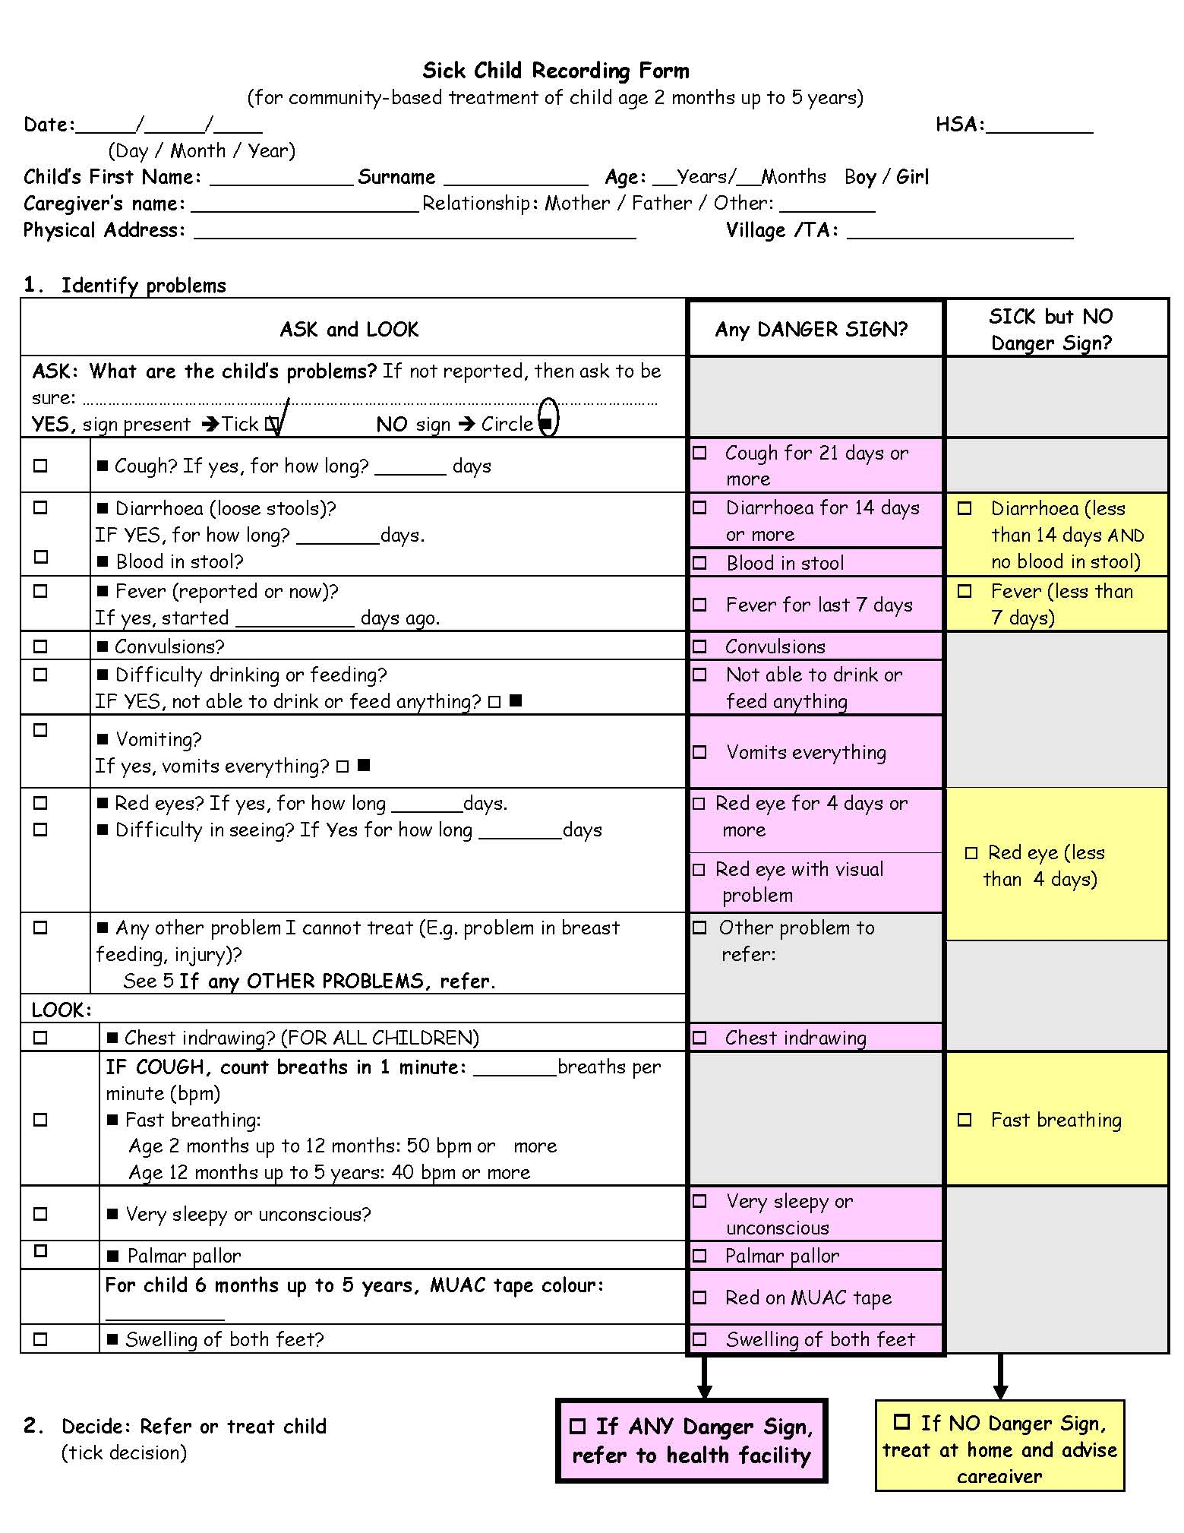
Essential features of CCM
HSAs trained to manage sick children aged 2-59 months with simplified WHO IMCI algorithm
Assess symptoms
Classify illness
Treat or refer (severe cases)
  Pneumonia ➔ antibiotics
  Fever / malaria ➔ antimalarials
  Diarrhea ➔ ORS and zinc
  Danger signs/severe illness ➔ refer

Slide 7
Essential Elements for effective CCM implementation
ELEMENTS
Train HSAs in CCM
Procure drug boxes; ORT equipment, bicycles
Provide support for DEC’s and TWG’s meetings
Support for orientation of Health Centre In-Charges
Support orientation of village health clinic committees
Support HSA quarterly review meetings
Support Mentorship program
Support training of senior HSA’s as VC supervisors
Strengthen drug management system
Strengthen M&E system
IMCI Unit MoH
6/7/2010
7

Slide 8
Progress in scaling-up of CCM
National target 2011: 2971 Village Health Clinics established
Currently achieved:
  1077 HSAs trained,
  978 VHCs established

Slide 9
Reasons for seeking care
Average number of cases treated per month per village clinic: 46 children

Slide 10
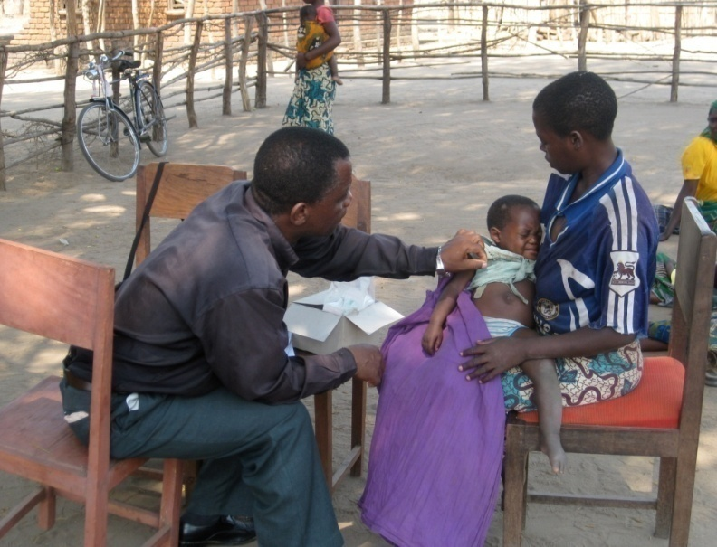
Can HSAs deliver services with quality?
Picture taken by J Callaghan, with permission, during practice observations in training of evaluation team

Slide 11
Assessment of quality of care June – Nov 2009
Objective 1: To determine the quality of care provided to sick children for pneumonia, diarrhea and malaria by HSAs in Malawi
Objective 2: To describe the processes in place to ensure the quality of CCM services provided by HSAs, including training, drug supply, and supervision

Slide 12
Use of multiple methods
Clinical Systems
Direct observation with Re-exam
Quality of assessment, classification, & treatment actions
Caretaker Exit Interview
Client satisfaction; counseling messages; costs
Case scenarios
HSA knowledge in severe cases
Register review
Cases seen; treatment & referral decisions
HSA Interviews
Drugs; supplies; supervision & training
Notes:
Observation of work sites and HSA interviews; systems level supports such as drugs, equipment available, frequency and quality of supervision; training and refresher training

Slide 13
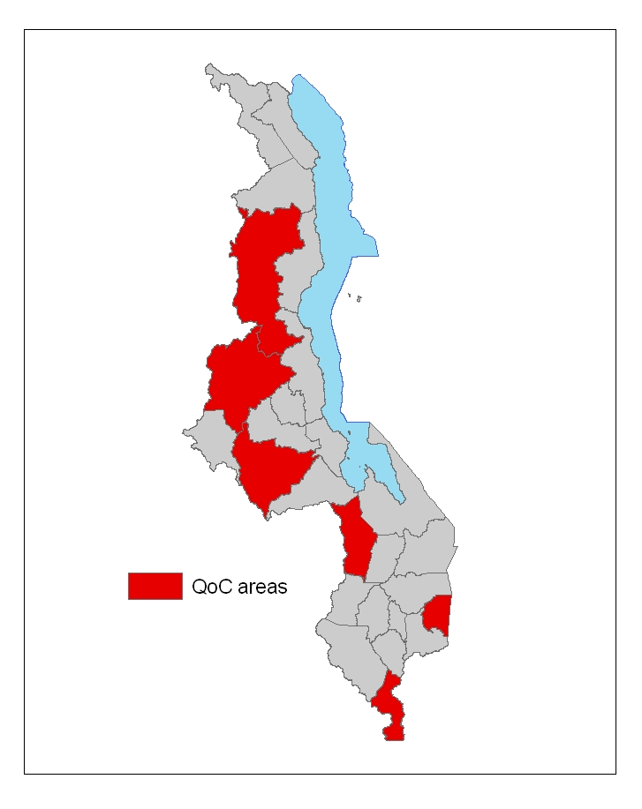
Methodology
Six districts
  HSAs trained in CCM
  Initial drugs available (functioning VHC)
HSAs randomly sampled
  22 per district
Data collection
  6 evaluation teams visited 131 HSAs
  Average of 1 HSA per day
  Average of 3.9 sick child observations per HSA
Mzimba
Kasungu
Lilongwe
Ntcheu
Phalombe
Nsanje

Slide 14
HSAs included in the sample
131 HSAs visited
Average Age = 34
82%
18%
43%
CCM Training
Notes:
14

Slide 15
Sick children and caretakers included in the sample
TOTAL Sick Children Observed = 385
Gold Standard Classifications
Diarrhoea < 14d 28%
Blood in stool 2%
Fever <7d 67%
≥ 7d 4%
Convulsions 2%
Vomits everything 2%
Red eye < 4d 8%
≥ 4 d 2%
Fast Breathing 26%
Palmar Pallar 2%
MUAC Tape Red 2%
Yellow 3%
Swelling both feet 2%
Other problems – refer 12%
19%
Sex of Child
~47% Girls
~51% Boys
Sex of Caretaker
95% Female
5% Male
Notes:
15

Slide 16
Assessment of sick children by CCM-trained HSAs

Slide 18
Proportion of caregivers who report satisfaction with HSA services

Slide 23
Summary of preliminary findings
Quality of assessment and treatment
  Relatively high, even in comparison to other surveys
Assessment of and referral for danger signs
  Need improvement
Counseling and communication
  Done well
  HSAs have more time for counseling than other workers
Systems supports (supervision, drugs & supplies)
  Need great improvements
  Still under development

Slide 24
What worked in Malawi?
MoH leadership and partner coordination
National guidelines and training materials derived from WHO/UNICEF generic package
Focus on hard-to-reach areas
District level orientation and joint planning
Community participation and ownership of the VHCs
Designation of referral facility and use of referral notes
Adoption of CCM register and monitoring system
SMS-based reporting of treatments provided

Slide 25
Tackling challenges
Introduction of programme management training, joint planning, and quarterly review meetings with DHMTs
Collaboration in MoH and with partners to strengthen forecasting, procurement and uninterrupted supply of medicines at the point of delivery
Institutionalizing mentorship program for HSAs in health centres
Creation on integrated supervision of HSAs by various cadres, and including observed case management

Slide 26
Acknowledgements
Malawi-MoH with:
MoWCD
WHO
UNICEF
Johns Hopkins University, IIP
USAID/BASICS
PSI
Save the Children
Bill and Melinda Gates Foundation
Canadian International Development Agency
The HSAs, district health teams, caregivers and children in Malawi
Picture taken by J Callaghan, with permission, during practice observations in training of evaluation team

