Slide 1
THE GEOGRAPHY OF COVERAGE
Professor Wendy J Graham
Immpact, University of Aberdeen
&
Dr Sennen Hounton
UNFPA, New York
Presentation for Countdown Equity Working Group
Women Deliver conference: June 7th 2010

Slide 2
The power of communication

Slide 3
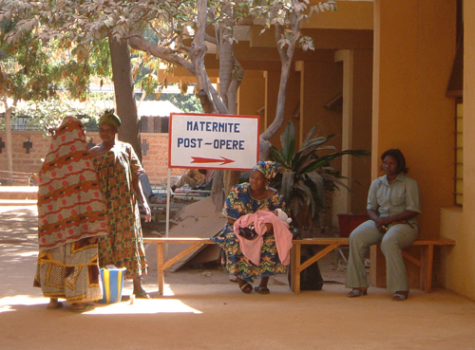
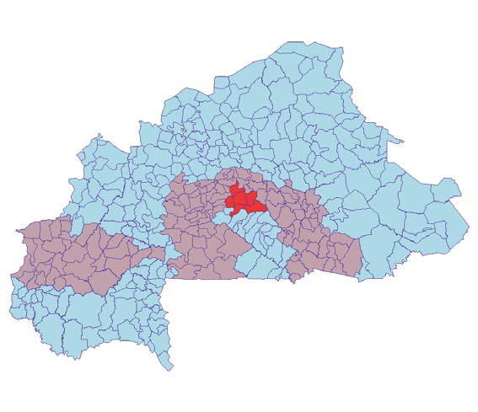

<0.8% 08-1.5% >1.5%
% of deliveries by caesarean section: Burkina Faso 2003

Slide 4
Capturing geographical inequities in coverage
Mean coverage index* for rural & urban areas
* Based on 8 maternal & child health services
Rural
Urban

Slide 5
Mean coverage index* & coverage gap across administrative regions
* Based on 8 maternal & child health services

Slide 6
Geographical inequities by types of service
* Midwives, nurses, doctors
Rural
Urban

Slide 7
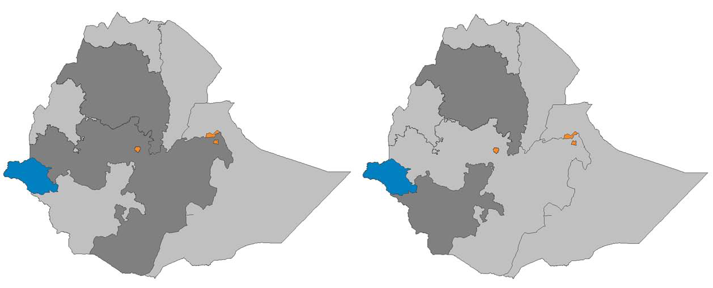

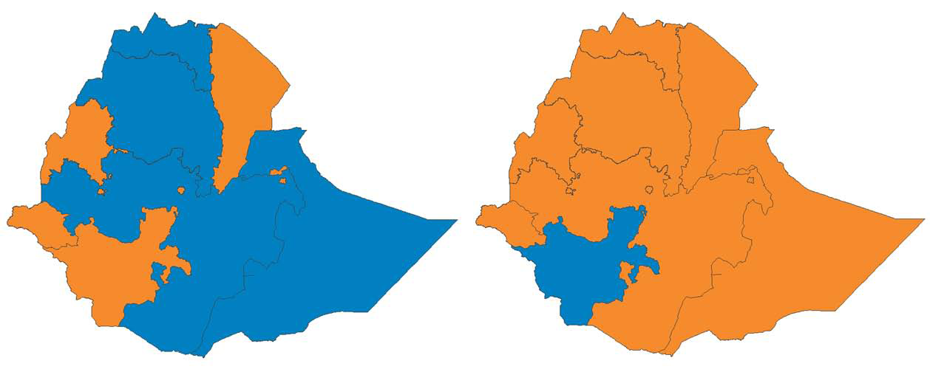
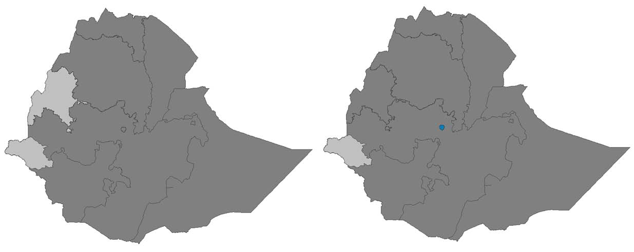
Tracking progress over space & time: deliveries with skilled attendants*,Ethiopia
% deliveries with skilled attendants
National
For urban population within regions
2000
2005
For rural population within regions
2000
2005
* Midwives, nurses, doctors
2000
2005

Slide 8
What are the reasons for geographical inequities?

Slide 9
Proportion of households in region in poorest category & mean coverage index: Ethiopia 2005
Inter-relationship with poverty
National % households poorest

Slide 10
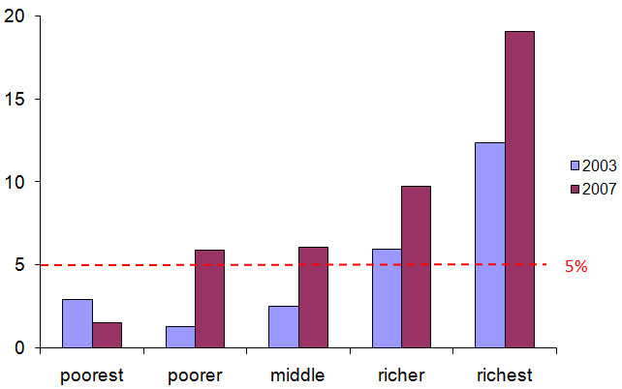
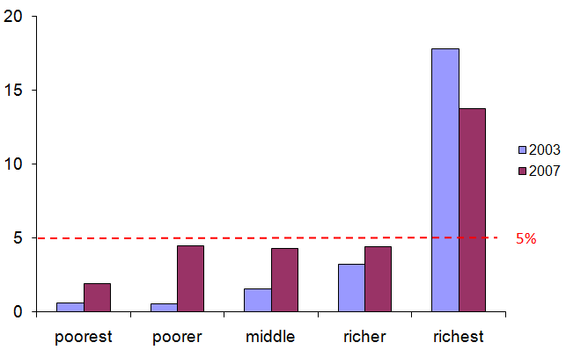
Financial barriers
Coverage of acute care in urban & rural areas: caesarean section, Indonesia
Urban
Rural

Slide 11
Physical barriers: distance
% deliveries in health facilities
Source: Immpact
Distance to health facility

Slide 12
Comparing coverage across administrative versus physical areas: Nepal 2006

Slide 13
What are the implications of geographical inequities?

Slide 14
Dipping-in-and-out of the health system: Nepal 2006
Continuum of care for woman, newborn and child across time

Slide 15
Policy implications
Geographic targeting of barriers to uptake of care: facility deliveries, Nepal 2005
Terrai
Source: Ensor et al, 2005; Immpact

Slide 16
Programme implications
INPUTS TO CARE
PROCESSES OF CARE:
EFFECTIVE COVERAGE
OUTCOMES OF CARE
Maternal mortality by distance to district hospitals: Indonesia 2004-6
Source: Immpact (Banten Province)

Slide 17
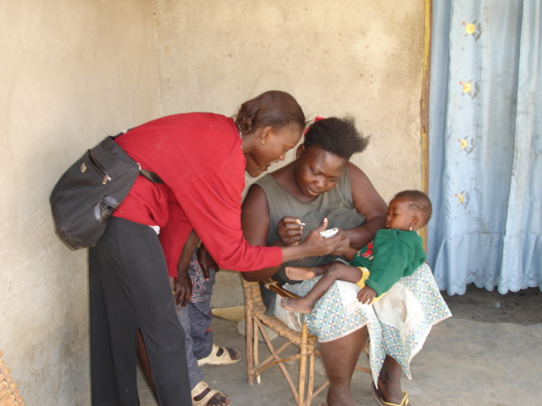
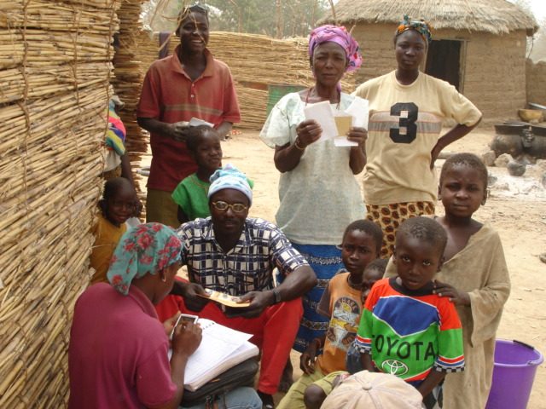
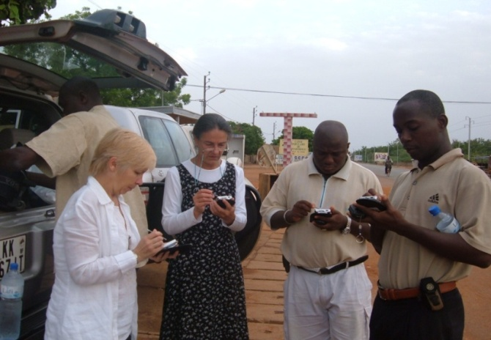
Data & research implications
Data gaps: inputs; barriers to access; quality of care; outcomes
Data-capture gaps: potential of technologies - GPS, mobile phones, PDAs
Communication gaps: “clever” maps - overlaying inputs, processes & outcomes

Slide 18
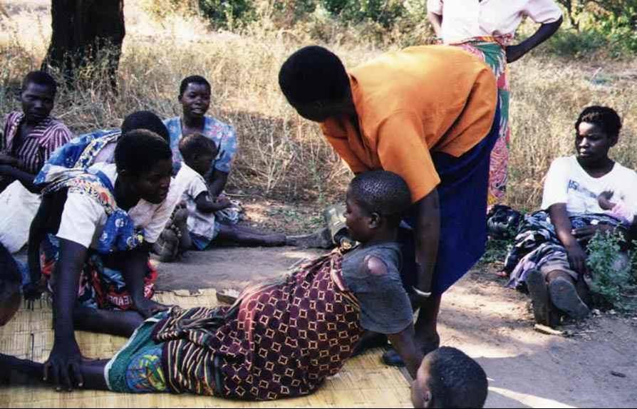
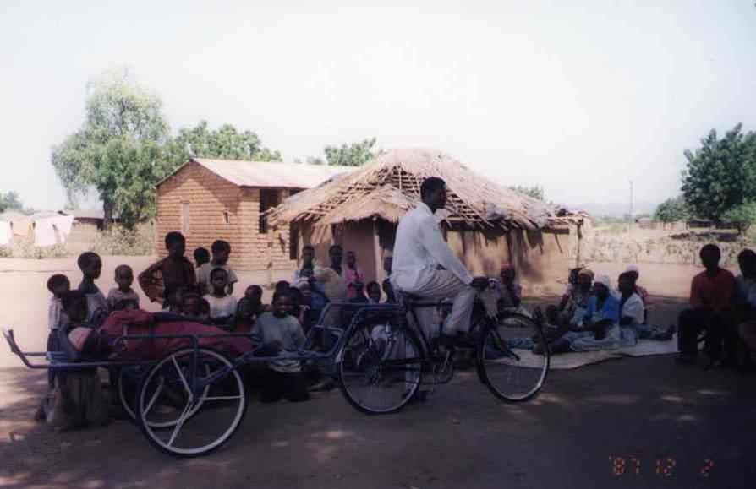
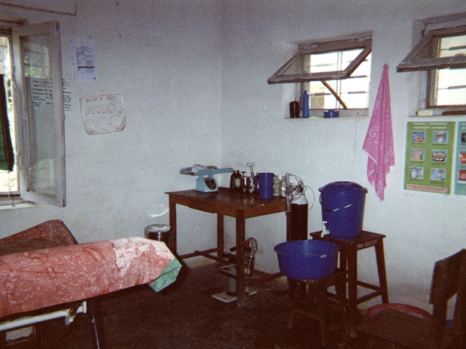
The Geography of Coverage: key messages
The power of communication: maps & other visual presentations of geographical inequities in coverage can appeal to many different audiences.
Reducing barriers to timely access to quality care: geographical inequities highlight barriers of special relevance to childbirth & so to achieving MDG4 & 5.

Slide 19
Acknowledgements
With special thanks to:
Immpact colleagues at the University of Aberdeen: Ann Fitzmaurice and Jacqui Bell
UNFPA for supporting parts of the analysis
Countdown to 2015 & Equity Working Group members
Thank you

