Slide 1
Mortality and Coverage:
Where are we in 2010?
(Part II)
Presented by:
Jennifer Bryce
Institute for International Programs
Johns Hopkins Bloomberg School of Public Health

Slide 2
Presentation Outline
Mortality and undernutrition
Progress in coverage for effective interventions
Action NOW to increase coverage

Slide 3
Mortality and undernutrition
Section 1:

Slide 4
MDG4:
Child Survival Status
Good news! 19 of 68 Countdown countries on track to achieve MDG4
17 countries have reduced child mortality by at least 50%
47 countries have accelerated progress since 2000
Notes:
Bullet 2: Give examples of countries with large declines.

Slide 5
MDG4:
Child Survival Status
Causes of under-five deaths
(Global)
Much work remains: mortality declines have slowed in 12 countries
Pneumonia, diarrhea and malaria remain the largest killers
Neonatal deaths are more than 40% of all under-five deaths
Undernutrition contributes to 1/3 of child deaths
Source: Black RE, Cousens S, Johnson HL et al., Global, regional and national causes of child deaths in 2010. Lancet 2010: On line publication, 12 May 2010.

Slide 6
Two-thirds of the world’s stunted children live in just 10 Countdown countries
Country | Stunting prevalence (%) |  | Number of stunted children (millions, 2008) | % of developing world total in 2008 (195.1 million)
India | 48 |  | ████████████████████████████████████████████████████████████ 60.8 | 31.2
China | 15 |  | ████████████ 12,.7 | 6.5
Nigeria | 41 |  | ██████████ 10,2 | 5.2
Pakistan | 42 |  | █████████ 9.9 | 5.1
Indonesia | 37 |  | ███████ 7.7 | 3.9
Bangladesh | 43 |  | ███████ 7.2 | 3.7
Ethiopia | 51 |  | ██████ 6.8 | 3.5
Congo, DR | 46 |  | █████ 5.3 | 2.8
Philippines | 34 |  | ███ 3.6 | 1.9
UR of Tanzania | 44 |  | ███ 3.4 | 1.7
 |  |  | Total | 65.5

Slide 7
MDG5:
Improve Women’s Health
Good news! Studies suggest progress in reducing maternal mortality
But progress is insufficient to achieve MDG5, especially in sub-Saharan Africa
And for every woman who dies there are 20 who suffer injuries, infection and disability

Slide 8
MDG5:
Improve Women’s Health
Most deaths occur around the time of childbirth
Leading cause of maternal death is postpartum haemorrhage; these deaths are largely preventable through skilled care at childbirth
*
*Indirect causes include deaths due to conditions such as malaria, HIV/AIDS and cardiac diseases.
Notes:
A maternal death is defined as the death of a woman while pregnant or within 42 days of termination of pregnancy, regardless of the site or duration of pregnancy, from any cause related to or aggravated by the pregnancy or its management.

Slide 9
Counting deaths is important…
but preventing deaths
by achieving
high, sustained and equitable coverage is even more important –
and is the focus of Countdown

Slide 10
Progress in coverage
FOR EFFECTIVE INTERVENTIONS
Section 2:

Slide 11
Variable coverage across the continuum of care
Gap:
Around Birth
Gap:
24-hr care
New
New

Slide 12
Trends in contraceptive prevalence rates for countries with highest and lowest rates around 2008.
Mixed progress
in family planning coverage since 2000
Notes:
note that funding has declined since 1990, and you could counter this negative with the example of Madagascar that showed with political commitment, community involvement and good program management the country was able to consistently increase contraceptive use from 1992 forward.

Slide 13
Antenatal care can save lives
IF visits are used to provide effective interventions
Median coverage for 4+ antenatal care visits is 50%, ranging from 6% in Somalia to 89% in Brazil
In 15 Countdown countries with HIV prevalence ≥ 5%, 9 showed major increases in coverage for PMTCT between 2006 and 2008

Slide 14
18 points
Variable progress in the proportion of women attended
by a skilled provider during childbirth.
23 points
21 points
The remarkable progress made in some countries can serve as an example for others.
21 points
17 points
Notes:
Strategies vary. In Rwanda, a “Paying for Performance” strategy increased institutional deliveries by providing financial incentives to providers to increase the use and quality of care.

Slide 15
Low caesarean section rates
indicate limited access
to emergency obstetric care
33 of the 51 countries with data since 2000 have rural C-section rates below 5%
Burkina Faso, Chad, Ethiopia and Niger have rates below 1%
Emergency C-sections now provided free of charge in more countries

Slide 16
Exclusive breastfeeding is a major contributor to child survival
Median rates of exclusive breastfeeding, most recent estimate since 2000
(59 countries)
(66 countries)
Source: UNICEF Global Database, Nov 2009
Compiled from MICS, DHS and other national surveys

Slide 17
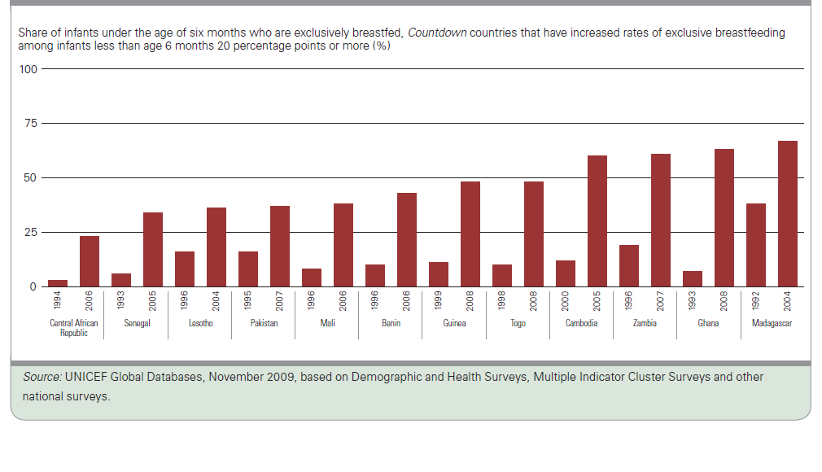
…and experience in Countdown countries shows rates can be increased

Slide 18
Some Countdown countries show rapid progress in preventing malaria through use of insecticide-treated nets
Roll Back Malaria target for 2010

Slide 19
Too few children with diarrhoea or pneumonia are receiving correct treatment

Slide 20
Saving lives from malaria requires the right medicine!
Proportion of children under five with fever receiving antimalarial treatment, by type of treatment
Summary for all malaria-endemic Countdown countries
 | Key |  | No. of Countries | Unweighted Median
 |  | ACT | 38 | 0.5
 |  | Chloroquine | 38 | 7.3
 |  | Other | 38 | 10.0
 |  | Total | 38 | 32.4

Slide 21
Open defecation
increases the risk
of diarrhoeal disease,
and is common
in some Countdown countries

Slide 22
Together, we can do better

Slide 23
Action NOW to increase coverage
Section 3:

Slide 24
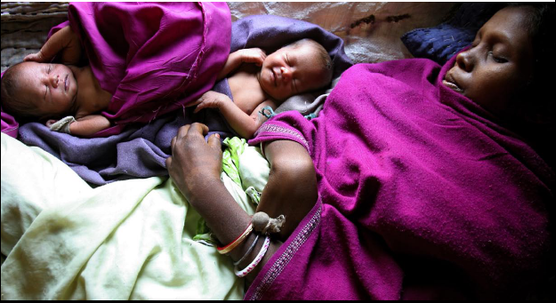
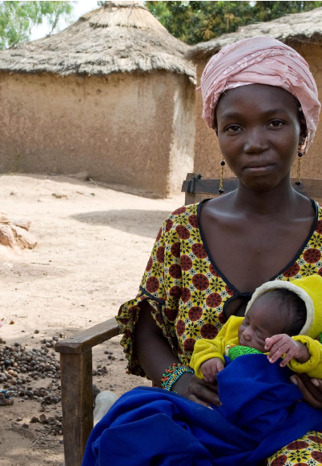
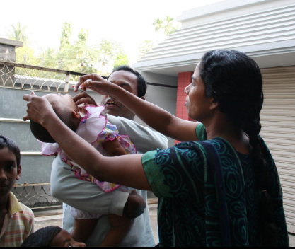
Action:
Quantify the coverage gaps
Track progress regularly
Country by country
Across the continuum of care

Slide 25
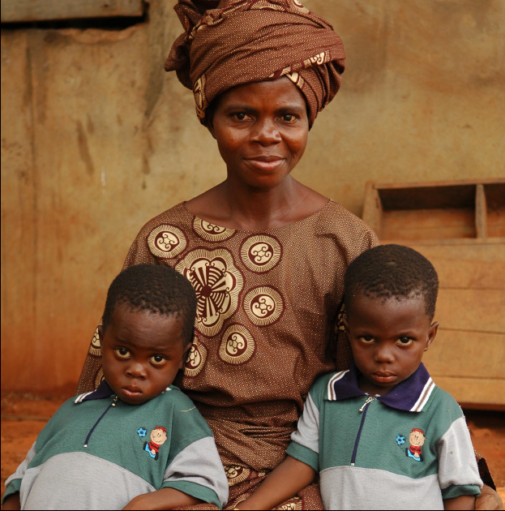
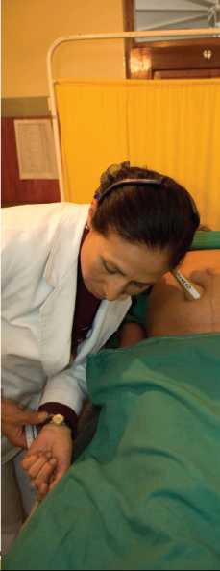
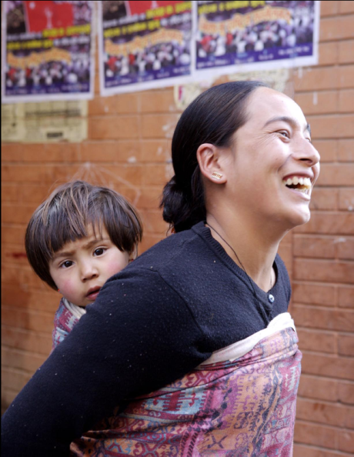
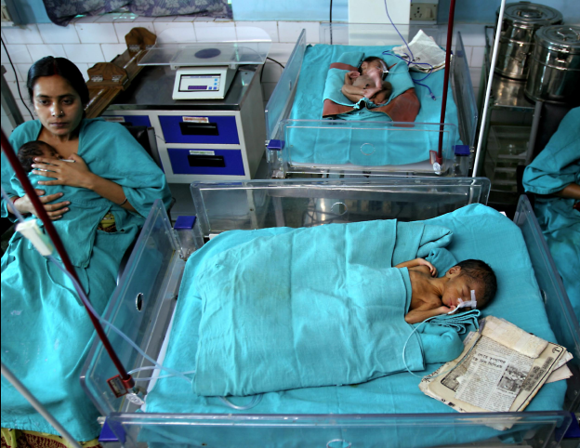
Action:
Deliver interventions close to home
Push delivery toward the community while improving access to all levels of care
Maintain and improve service quality
Focus resources on proven interventions with high impact on mortality

Slide 26
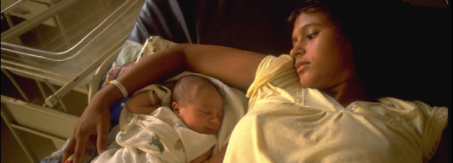
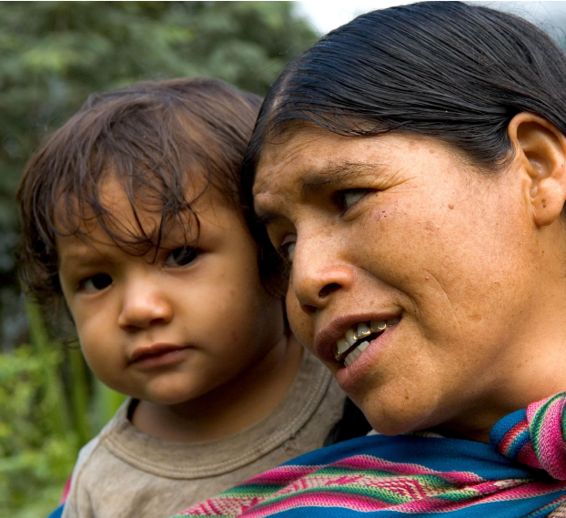
Action:
Address barriers to high, sustained and equitable coverage
Strengthen health systems and policies
Increase financial flows and targeting
Identify and redress inequities

Slide 27
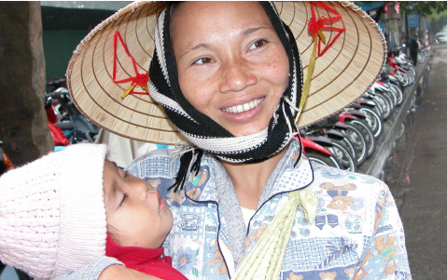
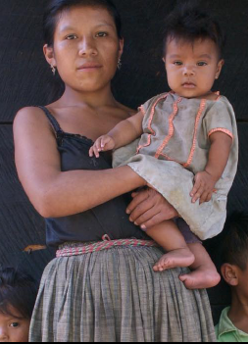

Action:
Refuse complacency
“Stay the course” in child survival
Make delivery safe for mothers and newborns
Re-energize family planning as a right of every woman

Slide 28
The country profiles
tell the real story
Countdown:
Harnessing the power
of good, recent,
country-specific information.

Slide 29
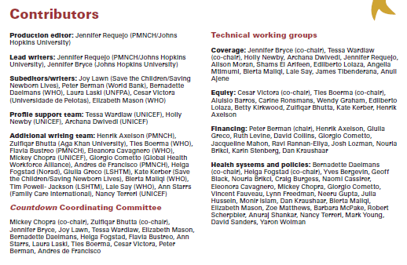
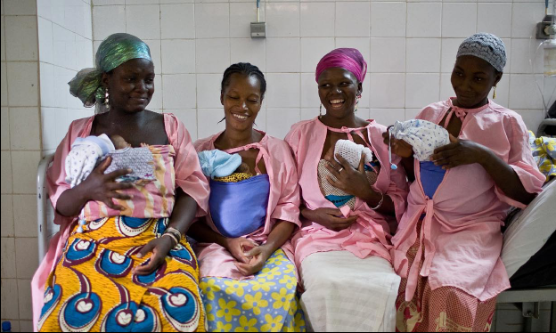
(FCI/PMNCH)

