Slide 1
Introducing
Countdown
Countdown to 2015 for Maternal, Newborn and Child
8 June, 2010
Washington DC, USA
Presented on behalf of Countdown by:
Zulfiqar A Bhutta
Co-Chair, Countdown Coordinating Committee
The Aga Khan University, Pakistan

Slide 2

Origins - 2003
Lancet Child Survival Series:
  10 million child deaths globally in 2000
  Effective interventions are available & can make a difference
  Coverage is unacceptably low and inequitable
  We need to MAKE NOISE
“We commit ourselves to convening a series of meetings, every 2 years, …[to] provide regular opportunities for the world to take stock of progress in preventing child deaths, and to hold countries and their partners accountable.”

Slide 3

Origins – 2004-5
Lancet Neonatal Series:
  4 million newborns die each year
  Effective interventions are available
  Coverage is unacceptably low
  We need to MAKE NOISE
“At the international level, greater accountability could be promoted, including … assessing the progress in neonatal health at the planned biennial conferences on child survival, the first of which will be held in December, 2005.”

Slide 4




Momentum built…
UNICEF makes child survival the #1 priority
PMNCH created

Slide 5
The Lancet provided a spotlight
Series, e.g.,
  Maternal survival (2006)
  Sexual & reproductive health (2006)
  Child development (2007)
  Undernutrition (2008)
Special Issues, e.g.,
  Countdown (2005 & 2008)
  Women Deliver (2007)
  Preterm birth (2008)
  Alma Ata (2008)
  And more!
Editorials, commentaries
Outlet for good science
Forum for debate
“The Countdown process ... has evolved rapidly into a scientific and social movement to prevent the
needless deaths of millions of mothers and children.”
Richard Horton
The Lancet

Slide 6
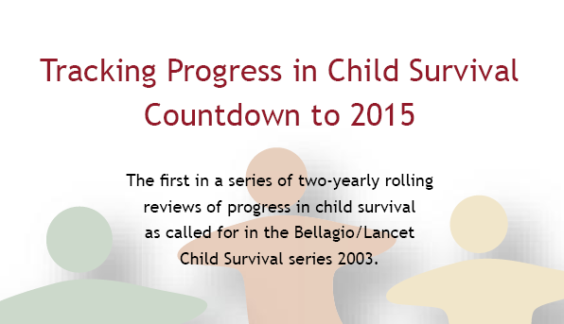

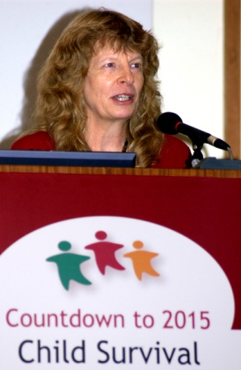
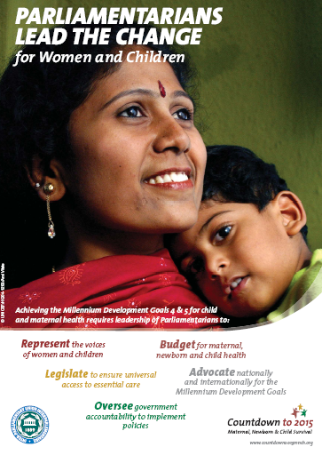
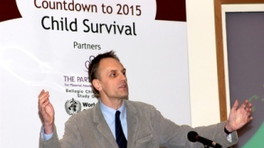


Global Countdown Conferences…
2005 in London
2008 in Cape Town
61 country delegations!

Slide 7
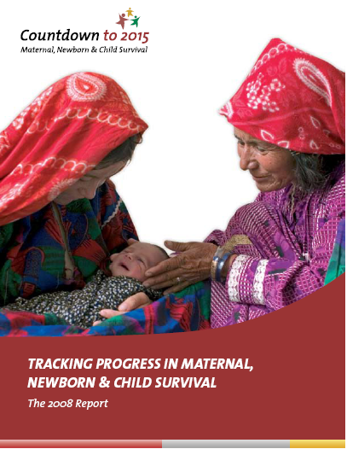
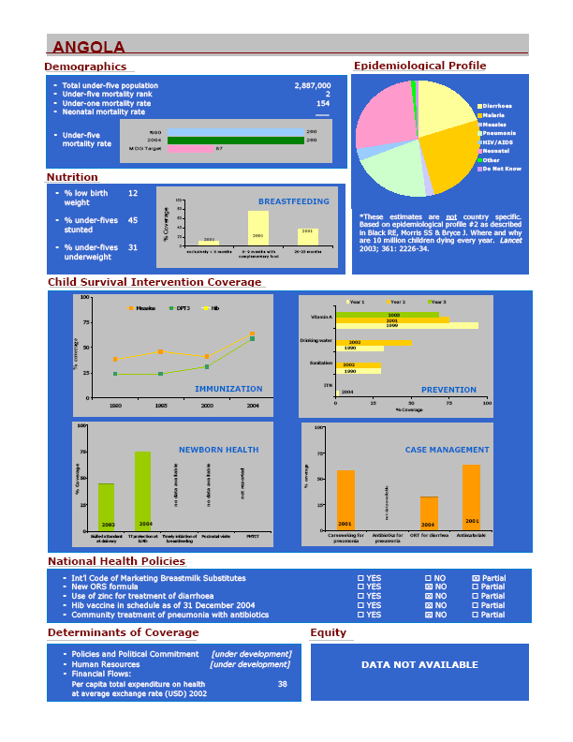
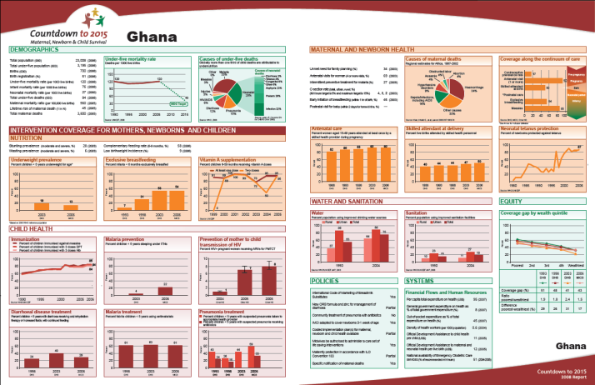
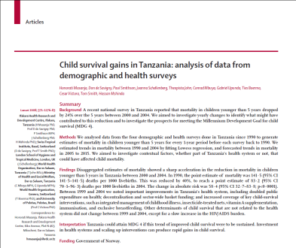
… and Countdown Products
Reports & media materials
Country Profiles
Publications
From Technical Working Groups
And from countries

Slide 8
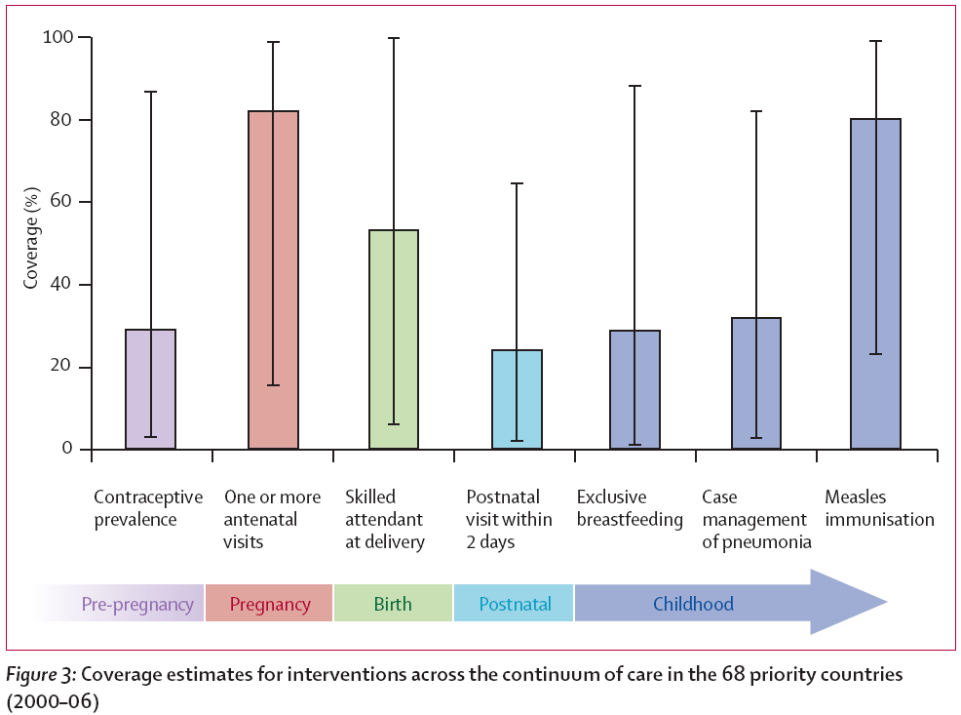
An evolution from child survival to the continuum of care

Slide 9
Who is Countdown?
Individuals: scientists/academics, policymakers, public health workers, communications experts, teachers…
Governments: MNC policymakers, members of Parliament…
Organizations: NGOs, UN agencies, donors, medical journals…
Notes:
agencies and individuals makers, academics, civil society, international agencies
o :
to reduce child and maternal mortality, and in parts of MDGs 1 (nutrition), 3 (gender) and 6 (HIV, malaria and infectious diseases)
Started with child health focus an individual child or mother more on the continuum of care, from before pregnancy, through pregnancy, childbirth and the portnatal period and on to early childhood.

Slide 10
Based on scientific evidence
All Countdown work reflects an effort to report on the best available data, collected with care and reported in ways that are fully transparent and permit replication of all analyses and results.
Focused on strengthening country programs.
Representatives of countries are involved in the decision-making processes of Countdown, including the selection of priority research topics and strategies for advocacy and accountability.
Respects and holds accountable all partners who adhere to its principles.
There is one set of rules that applies to all. Where gaps in evidence or disappointing outcomes are found, they are reported fully in the spirit of a multi-disciplinary “community of interest” with the shared mission of reducing MNC mortality.
Countdown Principles

Slide 11
Where is Countdown?
68 priority countries:
97% of maternal and child deaths
New Countdown work is under way in Asia and the Pacific.

Slide 12
What does Countdown do?
Tracks country-level coverage for interventions proven to reduce maternal, newborn and child mortality and associated indicators for
  Policies and health system strength
  Financial flows
  Equity
Analyzes country-level trends and recommends actions to accelerate progress
Identifies knowledge and data gaps
Promotes accountability for progress

Slide 13
What “set” of interventions?
All interventions must have evidence of:
Effectiveness
  Feasibility
    Affordability
      Availability
Plus indicators of coverage that are available in and comparable across the majority of Countdown countries

Slide 14
What is coverage?
The proportion of individuals who need a service or intervention who actually receive it

Slide 15
What makes coverage a good choice for global monitoring?
Complements country efforts
Good proxy for impact
Signals whether programme is operating adequately
Serves as “red flag” for further action, not comprehensive info for programme management
LiST
(Lives Saved Tool)
A computer program
that can turn
changes in coverage
for MNC interventions
into estimates of lives saved.
A companion for
Countdown!

Slide 16
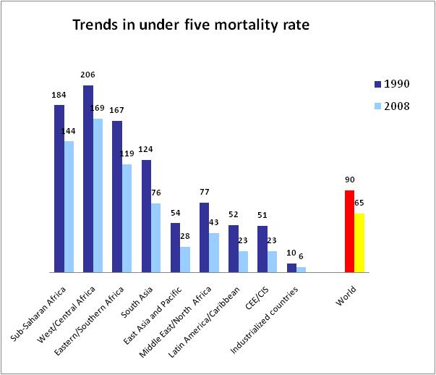
What does Countdown track in addition to coverage?
Mortality, nutritional status and causes of death
Key determinants of coverage
IGME, as reported in Lancet, 10 September 2009.
Equity in coverage
Beginning to include social determinants

Slide 17
What does Countdown mean to people like me?
An independent, credible body for marking progress or lack thereof in key areas of MNCH
An integration platform: how can we do this together? Bringing in issues of
  Health systems
  Global & National investments
  Equity and Justice
  Social determinants
  Community engagement and empowerment
  Human Development

