Slide 1

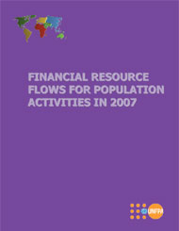
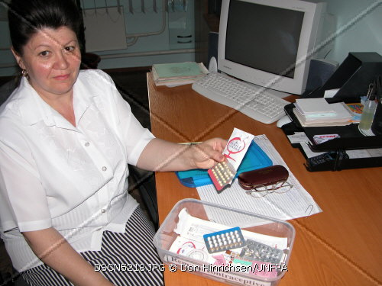
Financial Flows for Family Planning,
Countdown to 2015
Women Deliver Conference
Stan Bernstein
UNFPA

Slide 2
Objectives of the Presentation
Highlight Donor financial resources flow trends for Family Planning (1999 – 2008) in the context of population and reproductive health programmes;
Address Resource Requirements for Family Planning in relation to the ICPD and the Millennium Development Goals;
Further inform the Policy Dialogue (global, country) in positioning and leveraging for Family Planning as part of an integrated package of services.
Notes:
In terms of Resources Flows, the Presentation draws heavily from the UNFPA publication “Financial Resource Flows for Population Activities in 2007” (Dec. 2009) and 2008 (forthcoming Publication).
In terms of Family Planning Future Resource Requirements, the presentation utilises data from the High Level Taskforce on Innovative International Financing for Health Systems, specifically ‘Constraints to Scaling-Up Health related MDGs: Costing & Financial Gap Analysis’ (WHO) and UNFPA, Revised Cost Estimates for the Implementation of the Programme of Action of the International Conference on Population & Development: A Methodological Report (2009).
FAMILY PLANNING SERVICES are defined as contraceptive commodities and service delivery; capacity-building for information, education and communication regarding family planning and population and development issues; national capacity-building through support for training; infrastructure development and upgrading of facilities; policy development and programme evaluation; management information systems; basic service statistics; and focused efforts to ensure good quality care.

Slide 3
Methodology
Resource Flows, based on the UNFPA publication “Financial Resource Flows for Population Activities in 2007” (Oct. 09) and 2008 (Preliminary).
Family Planning Future Resource Requirements taken from the High Level Taskforce on Innovative International Financing for Health Systems, ‘Constraints to Scaling-Up Health related MDGs: Costing & Financial Gap Analysis’ (WHO) and UNFPA, ‘Revised Cost Estimates for the Implementation of the Programme of Action of the ICPD: A Methodological Report’ (2009).
Notes:
Resource Flows: Since 1997, the Netherlands Interdisciplinary Demographic Institute (NIDI), under contract with and in collaboration with UNFPA, has carried out the data collection. To build regional capacity to monitor resource flows, UNFPA and NIDI also work with the Indian Institute of Health Management Research (IIHMR). Working with UNFPA, NIDI created a resource-flows database of both donor and domestic resources that is updated regularly. NIDI also carries out evaluation and analysis of the data in collaboration with UNFPA. In addition, 15 case studies were conducted to supplement the information gathered in the inquiry. Real-time estimates are produced to complement existing trend analysis.

Slide 4
Why Monitor Financial Resource Flows?
Monitoring financial resources is critical for:
  Country planning and budgeting processes;
  Reviewing & assessing financial performance;
  Informing the policy dialogue (country, global);
Tracking financial resources is key to:
  addressing where and how funds are utilised :
  monitoring equity, efficiency, and effectiveness issues;
  strengthening mutual accountability;
  advocating to mobilise additional resources.

Slide 5
Challenges in tracking Family Planning Financial Data
With the integration of services its difficult to disaggregate individual components such as Family Planning from a comprehensive package of services;
Harmonised donor financing modalities, such as Joint Financing, Basket Funding, Sector Budget Support and General Budget Support make it complex to track the level of funding going to Family Planning.

Slide 6
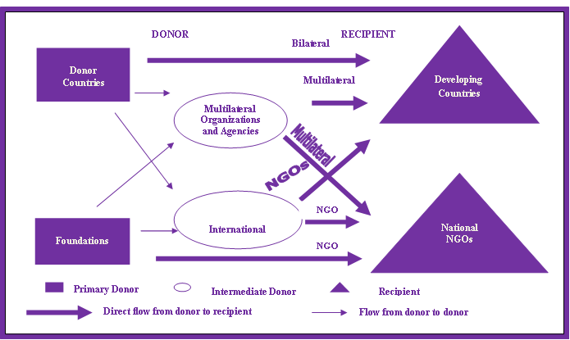
Family Planning Financial Flows
Notes:
Assistance for Family Planning flows through a complex network, from donors to recipients through several channels. The channels include: (1) bilateral assistance directly from the donor-country Government to the recipient-country Government; (2) multilateral assistance, through United Nations organizations and agencies and (3) foundations and international NGOs. The international population assistance network includes two groups of donors: (1) primary donors, which are developed countries and private foundations and (2) intermediate donors, which are multilateral organizations and agencies, the development banks and international NGOs that channel most of the primary donors' funds for population assistance.

Slide 7
Trends in FP Financing
Notes:
The proportion of funding for family planning services has decreased over the years with the largest and increasing share of total population assistance going to fund HIV/AIDS activities. This trend will have serious implications for countries' ability to address unmet need for such services and could undermine efforts to prevent unintended pregnancies and reduce maternal and infant mortality. In 2007, while the percentage share for family planning remained the same, the actual amount of funding increased to $517 million in 2008 from $462 million in 2007. While encouraging, this is still below the funds mobilized in the immediate post-ICPD years and far below the amount required to meet current needs.

Slide 8
Trends in Total Donor Financing for Basic RH-Services

Slide 9
Trends in Total Donor Financing for STIs & HIV/AIDS

Slide 10
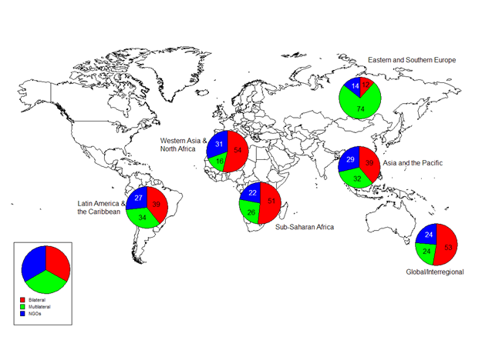
Donor Spend for Population Assistance, incl. Family Planning 2007

Slide 11

Resource Requirements for Family Planning

Slide 12
High Level Taskforce on Innovative International Financing for Health Systems: WHO Estimates

Slide 13
HLTF calculations for 49 IDA countries (subset of the total). Costs were divided into programs and systems costs.
Programs (26% of total costs)
Management of childhood illness
Immunizations
Maternal Health
Family Planning
TB
Malaria
HIV/AIDS
Essential Drugs (NCD, MH, Parasitic Diseases)
Systems (74% of total costs)
Governance
Infrastructure
Equipment and Vehicles
Human Resources
Supply Chain/Logistics
Health Information Systems
Financing

Slide 14
Programs costs comprised 76% of the total costs. Family planning costs were less than $1 per capita per year.

Slide 15
Family Planning program costs were estimated to cost a total of $8.4 B from 2009-2015 in order to achieve Universal Access, less than $1 per capita per year.
Universal Access was defined as reducing current unmet need to 0 while assuming the same contraceptive method mix
These 49 IDA countries had a population of around 1.5 Billion or about 20-25% of the population in less developed and least developed countries.

Slide 16
ICPD @ 15 Costing

Slide 17
The ICPD costing exercise estimated the costs for developing countries was estimated using 5 cost categories: Family planning related activities belonged to two of those categories
Cost Categories
(1) HIV/AIDS
(2) Basic Research/ Data/Policy Analysis
Sexual/Reproductive Health/Family Planning
(3) Maternal Health Direct Costs
(4) Family Planning Direct Costs
(5) Programmes and Systems Related Costs related to maternal health and family planning

Slide 18
Family planning direct costs (drugs supplies and personnel) were projected to rise to around $4 B by 2015. These costs were significantly smaller than 3 of the other 4 cost categories.

Slide 19
Family planning direct costs were projected to be significantly smaller than the health systems costs needed to support family planning and maternal health.

Slide 20
The majority of the family planning direct costs were projected to be in Asia and the Pacific with sub-Saharan Africa’s percent increasing over time
2010
2015

Slide 21
The majority of the family planning direct costs were projected to be in Asia and the Pacific with sub-Saharan Africa’s percent increasing over time

Slide 22
